Slide 1
SERIES & PARALLEL CIRCUITS

Slide 2

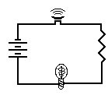

Slide 3
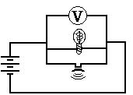

Slide 4
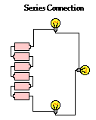
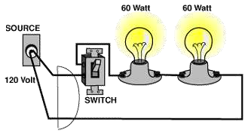
SERIES CIRCUIT:
-There is only ONE PATH for the electrons to take between any two points in the circuit.
*There will be no alternative
route.
-Has more than one RESISTOR. Since there is only one path for the current to travel, the current through each of the resistors is the same.
*Resistors are components that are used to control the amount of current flowing in a circuit.

Slide 5
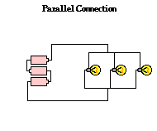
PARALLEL CIRCUITS:
-Two or more components are connected between the same two points.
- Has more than one resistor and gets its name form having multiple paths to move along.
* Charges can move through any of the several paths. If one of the items in the circuit is broken, then no charge will move through that path. But other paths will continue to have charges flow through them.

Slide 6



Slide 7
RECAP! ☺
 | SERIES CIRCUIT | PARALLEL CIRCUIT
DESCRIPTION | If one the items in the circuit is broken, then no charge will move through the circuit because there is only ONE PATH. | If one of the items in the circuit is broken then no charge will move through that path, but OTHER PATHS will continue to have charges flow through them.
RESISTOR | As more resistors are added, the overall current in the circuit decreases. | As the number of resistors increases, the overall current also increases.

Slide 8
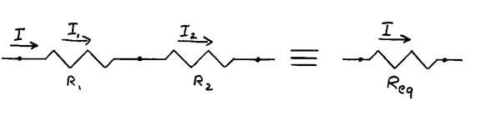
EQUIVALENT RESISTANCE
-Is the amount of resistance that a single resistor would need in order to equal the overall effect of the collection of resistors that are present in the circuit.
RESISTORS IN SERIES:
Two resistances are connected in series if all the current from one resistor must flow through the second; there is no alternative route.

Slide 9

Equivalent resistance:
From conservation of charge:
I₁ = I₂ = I
where I is the current through the combination.
From conservation of
energy:
V₁ + V₂ = V
where V is the potential difference across both resistors.
The two resistors can be replaced by a single
resistor with the equivalent resistance
For more than two resistors, R_{eq} = R₁ + R₂ + R₃ + ...

Slide 10
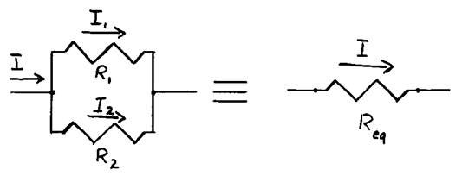
RESISTORS IN PARALLEL:
- Two resistors are connected in parallel if they are joined at both ends such that the potential difference across both resistors is the same. The current splits, flows through the two resistors, then comes back together with no alternate path.

Slide 11


Equivalent resistance:
From conservation of charge:
From conservation of energy:
I₁ + I₂ = I
V₁ = V₂ = V
The two resistors can be replaced by a single resistor with the equivalent resistance Req:
For more than two resistors:

Slide 12
RECAP! ☺
SERIES CIRCUIT | PARALLEL CIRCUIT
The total resistance of the | The inverse of the total
circuit, also called effective | resistance of the circuit, is
resistance is equal to the | equal to the sum of the
sum of the individual | inverses of the individual
resistances. | resistances.
R = R₁ + R₂ + R₃ + … | 1/R = 1/R₁ + 1/R₂ + 1/R₃ + …

Slide 13
Electric Power:
ELECTRIC POWER AND ENERGY
Represents the rate at which energy is converted from the electrical energy of the moving charges to some other form.
The SI unit of power is watt.
Electric Energy:
-Represents the presence and flow of an electric charge. The energy portion of electricity is found in a variety of phenomena such as static electricity, electromagnetic fields and lightning.
-Consumption of electrical energy is measured by Watt x Hour (Wxh)
* 1Wh = 3600 joule = 859.8 calorie

