Slide 1

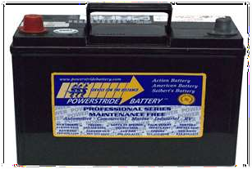


Slide 2

Electric Cell vs a Battery
Principle of operation of electric cell
Categories of electric cells
Primary Cell
Secondary Cell
Evolution of the electric cell
Electric Cells in Series
Electric Cells in Parallel
Electric Cells in series- Parallel
Internal Resistance
Difference between potential difference and electromotive force

Slide 3





Electric Cell - An electric cell is a device that converts chemical energy into electrical energy.
Battery - Is an electrical energy source consisting of two or more electric cells connected together.

Slide 4
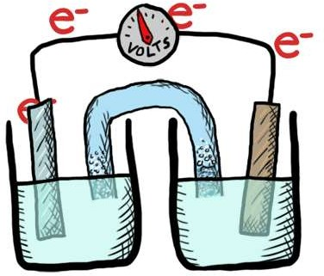

If two electrode plates of different conducting material (e.g. copper and zinc) are placed in a solution (the electrolyte) of salts, acids or alkaline, a voltage will appear between them.

Slide 5

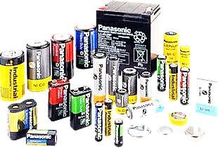

Electric cells fall into two category. These are:
Primary cells and
Secondary cells

Slide 6
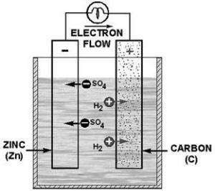

These are electric cells that cannot be recharged electrically. This cell can only be replenished by renewal of the active materials (i.e. putting pellets of sal ammoniac into the electrolyte).

Slide 7




1. Cheap
2. Requires little maintenance

Slide 8


Cannot be recharged electrically
Incapable of supplying heavy currents.
More cells are needed for a given output voltage
The cell cannot be used continuously due to the effects of polarization.
Has a high internal resistance due to resistance of the plates and the electrolyte.

Slide 9





1. These batteries are used to operate components such as flashlights, watches, radios, clocks, remote control, toys, games, etc.

Slide 10

Simple Leclanche/ cell
Alkaline cell
Silver Oxide cell
Mercury cell
Lithium cell

Slide 11

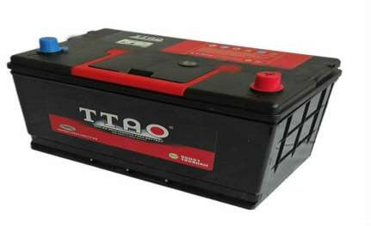


These are electric cells that may be recharge electrically.

Slide 12



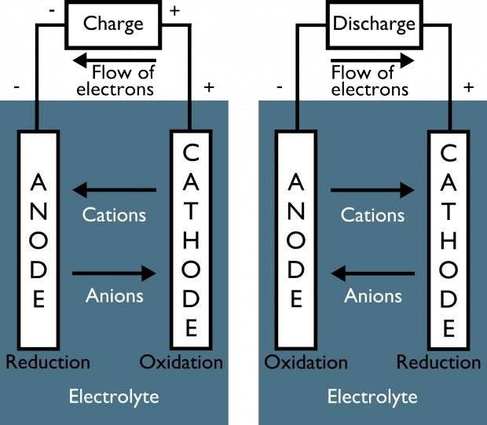

Chemical energy is converted into electrical energy when the cell is discharging, and electrical energy is converted chemical energy when the cell is being charged.

Slide 13


It can be recharge
Capable of supplying heavy current
Higher voltage per cell
Lower internal resistance
Longer lasting

Slide 14
They are expensive
Lacks mechanical strength
Self discharging
Plates shed easily
Require careful maintenance

Slide 15


Used in extreme of high temperature and in conditions where vibration is experienced.
Stand -by- supplies
Motor vehicles etc.

Slide 16


Lead-acid cell
Zinc chlorine cell
Nickel iron cell
Lithium iron sulfide cell
Nickel cadmium cell
Sodium Sulfide cell
Nickel zinc cell
Plastic cell
Alkaline cell
Solar cell

Slide 17

The effective voltage is increased when electric cells are connected in series. To find effective voltage E_{T} = E₁ + E₂ …+ E_{N}.
the current remains the same I_{T}=I₁=I₂= I₃

Slide 18

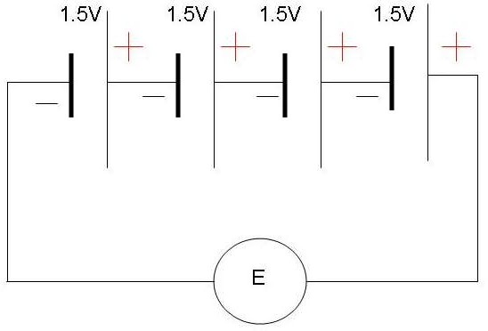

Calculate the effective voltage of the combination of electric cells connected in series in the diagram below

Slide 19

To find effective voltage E = V₁ + V₂ +V₁ + V₂ E =1.5V + 1.5V+1.5V+1.5V
E =6V

Slide 20



Current increases when cells are connected in parallel
To find effective current I_{T} = I₁ + I₂……+ I_{N}
while the voltage remains the same.
E₁ = E₂ = E₃
NB: Cells of different potential such as voltage and
current should never be connected in parallel.

Slide 21

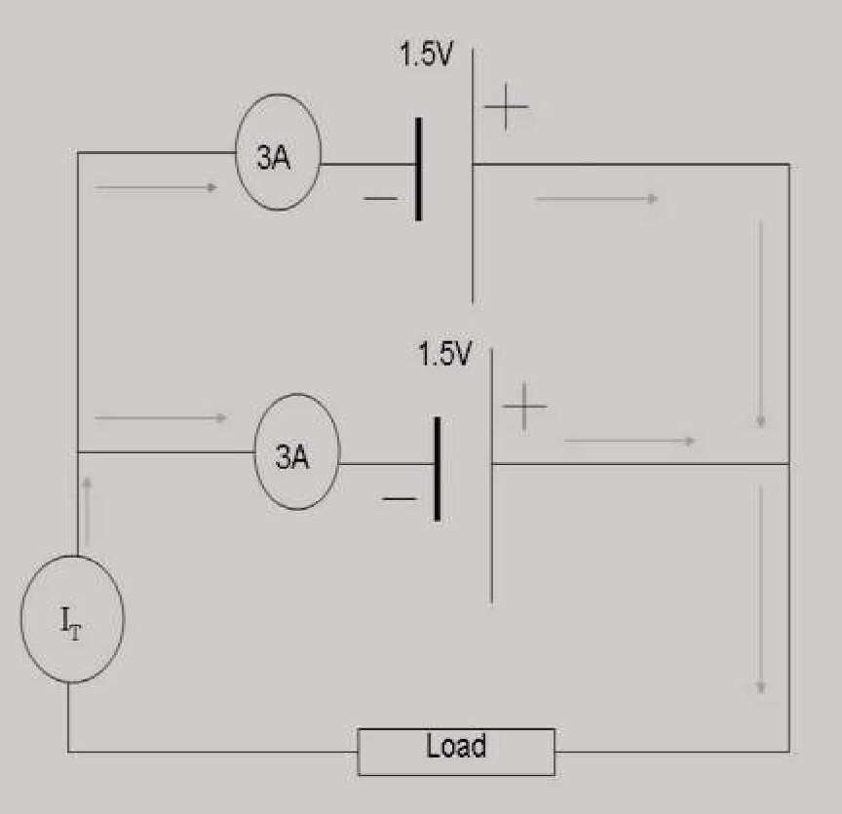

Given that a cell has a current rating of 3A and connected in parallel to a cell of identical current and voltage rating.
Calculate the total current output.

Slide 22


To find effective current I_{T} = I₁ + I₂ I_{T} =3A + 3A
I_{T} =6A

Slide 23



Both voltage and current increases when cells are connected series-parallel.
This combination increases the life of the battery.
To find effective voltage E_{T} = E₁ + E₂ …+ E_{N}
To find effective current I_{T} = I₁ + I₂……+ I_{N}

Slide 24


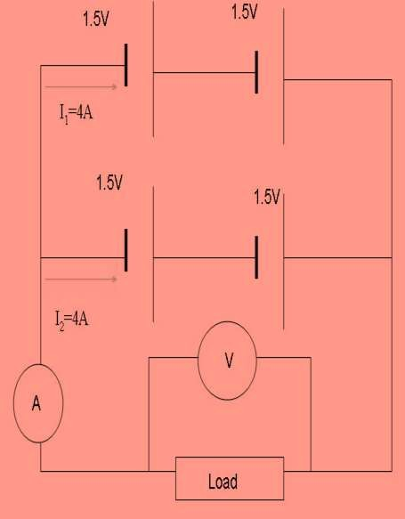

Given the arrangement of the series-parallel Cells combination below. Calculate the effective voltage.

Slide 25

Since two 1.5V electric cells are connected in each branch The total voltage in each branch is E=1.5V+1.5V=3V(series connected).
Therefore the effective voltage is 3V(since the load is connected across the two branches) The effective current is I_{T} = I₁ + I₂
I_{T} = 4A+4A=8A

Slide 26

Every cell has an internal
resistance due to the
resistance of the plates and the electrolyte.
When a battery fails, it is
typically because it has
built up enough internal
resistance that it can no
longer supply a useful
amount of power to an
external load.
when cell is connected to
an external circuit current
flows and there is a
voltage drop across the
internal resistance and
this is why Potential
difference is less than the
EMF because of internal
resistance.

Slide 27

Calculating the internal resistance of a cell when given the current, e.m.f and
p.d
r = e.m.f - p.d
I
Example 1: A cell has an e.m.f of
1.52 V When it is connected to the load, the terminal voltage falls to
1.45 V and a current 2mA is flows. What is the value of the internal resistor?

Slide 28

Given
E= 1.52 V V=1.45 V I=2A
r = 1.52 V- 1.45 V
2mA
r = 35Ω

Slide 29

It is impossible to directly measure the internal resistance of a battery, but it can be calculated from current and voltage data measured from a circuit. When a load is applied to a battery the internal resistance can be calculated from the example we worked here .

Slide 30


Electromotive Force (e.m.f )
difference in electric potential, or voltage, between the terminals of a source of electricity, e.g., a battery from which no current is being drawn
Open circuit voltage
Larger than the p.d value
Potential Difference (p.d.)
the difference in electrical charge between two points in a circuit expressed in volts
closed circuit voltage
smaller than the e.m.f value

Slide 31

An Electric Cell is :
a power generating device which converts the stored chemical energy into electrical energy.
a device which converts solar energy into electrical
energy
a device which converts electrical energy into chemical energy
a power generating device which converts electrical
energy into stored chemical energy.

Slide 32


What is the difference between a secondary cell and a primary cell?
Primary cells can be recharged electrically and a secondary cells cannot
Secondary cells can be recharged electrically and a primary cells cannot
Both cells can be recharge electrically
Both cells cannot be recharge electrically

Slide 33


When cells connected in series:
The current increases
Both voltage and current will increase
The effective voltage decreases
The effective voltage increases

Slide 34

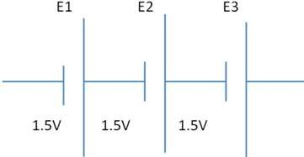
the total voltage for the arrangement of electric cells above is:
1.5V
3V
4.5V
d. 3.38V

Slide 35


When cells are connected in parallel:
The effective voltage increases
The current increases
Both voltage and current will increase
The effective voltage decreases

Slide 36


All are advantages of a secondary cell EXCEPT:
It can be recharge
Capable of supplying heavy current
Longer lasting
Requires little maintenance

