Slide 1
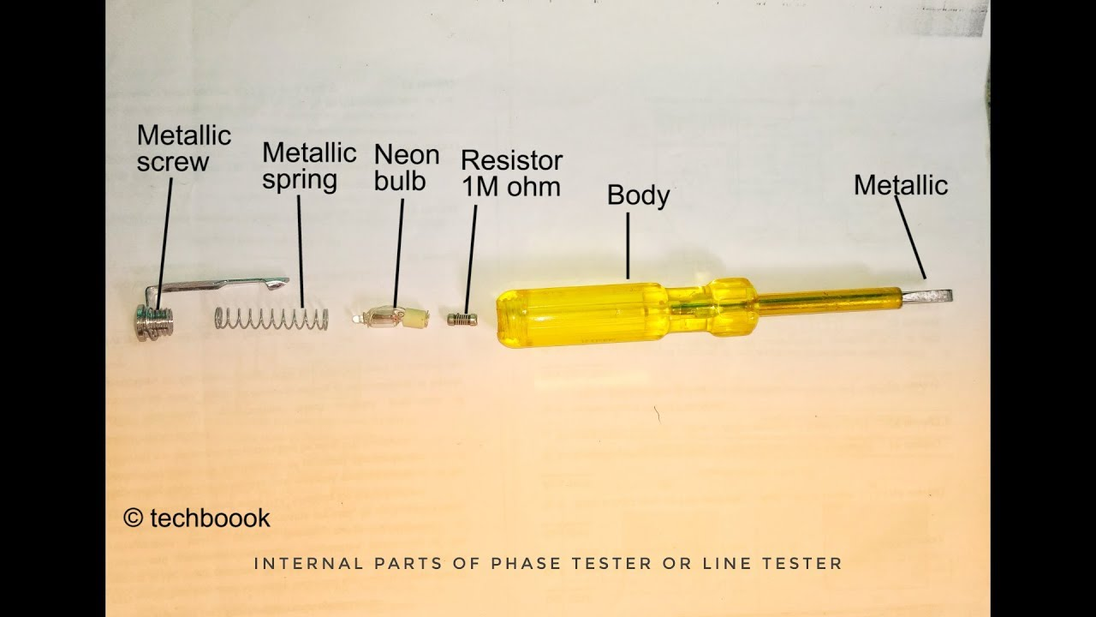
Line Tester

Slide 2
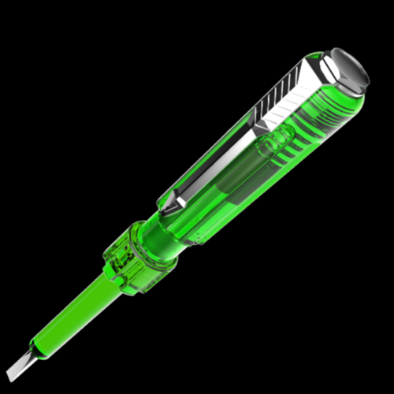
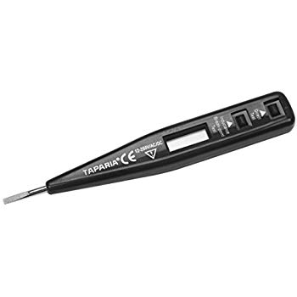
Line Testers
Digital Line Tester
Tester with Neon Lamp

Slide 3
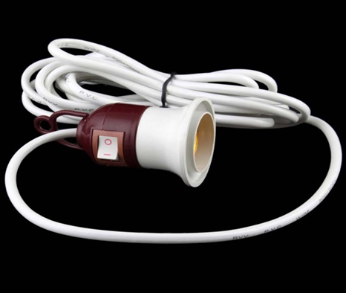
Test Lamp

Slide 4
Electrical Line Tester
Introduction:
Tester is one of the simplest solution, used to detect current and voltage continuity in any circuit.
The user is required to be on the floor while using the tester so that he can serve as ground when current flows.
In order to test the live wire, the user’s body must be in contact with the metal cap on the top of the screwdriver, when the tester is put in contact with the wire. This completes a genuine electrical circuit and the bulb will light up once the tester sense electric current.

Slide 5
Construction of Electric Phase or Line Tester
Metallic Rod and Mouth
It is a cylindrical metal rod.
The flat end (mouth) is used as a screw driver or touch electrical conductors/wires to find phase or live wire and the other end is connected to the resistance, neon bulb, element and metallic cap screw respectively.
The flat end of cylindrical metal rod is also covered with transparent insulated plastic for insulation purpose except mouth.

Slide 6
Body and Insulation
All these components (Resistance, Neon bulb, Element or metallic spring, and Metallic Cap screw) are covered in a transparent insulated body which is made up of plastic.
The flat end of cylindrical metal rod is also covered with transparent insulated plastic for insulation purpose except mouth.
Resistor
Resistor is an element which opposes the flow of current through it.
In a Phase or Line Tester, Resistor is connected between cylindrical metal rod and Neon bulb, to prevent the flow of high current and reduces it to a safe value for Neon bulb.
Without a resistor, high current may damage the neon bulb. Moreover it would not be a safe to use this tool without resistor.

Slide 7
Neon Bulb
Neon bulb is connected between Resistance and Element (metallic spring). It is used as phase indicator bulb. When a small current flows through it, it glows. Due to neon bulb, a Phase or Line tester is also called a Neon Screw driver.
Element (Metallic Spring)
Element (metallic spring) is used to make connection between neon bulb and metallic cap screw.
Metallic Cap Screw and Clip
Metallic Cap screw is used to tight all the components inside the Phase tester slot. In addition, Metallic cap screw is connected with spring (element) and spring (element) is connected with neon bulb. Moreover Clip is used for holding the phase tester in pocket.

Slide 8
Working of Electric Phase or Line Tester
To test the presence of 'Alternating current' (AC), electric line tester is used.
In Electric line tester, when we keep the pointed end of the tester in contact with the wire through which electric current is passing and touch the metal cap at the other end, a small amount of current passes through the neon bulb, high resistor in the tester and through our body to the earth (which is at zero potential).
Here the body completes the electric circuit which makes the neon bulb to glow.
If the bulb glows, it means the current is passing through the wire. High resistance in the tester allows only small amount of current to pass through our body.

Slide 9
Test Lamp
Test Lamp is a simple electric circuit used to check availability of electric power at power outlets.
It is also important tool to check availability and efficiency of electrical Earthing.
It can be prepared with the two pieces of flexible wires and pedant lamp holder.
Lamp used for Test Lamp should be of100watts with clear glass. While testing the earthing if lamp glows with full brightness-Earthing is Good; if it glows with less brightness-Earthing is Poor; if lamp doesn’t glow- Earthling is not available.
Test lamp can also be used to detect Neutral wires from a group of wires inside the switch board and distribution board.

