Slide 1
SERIES AND PARALLEL
HOW WE WIRE THE WORLD

Slide 2
Series and parallel circuits
Learning Objectives:
Know differences between series and parallel circuits.
Starter:
Match up the symbols with the words and pictures of components.

Slide 3
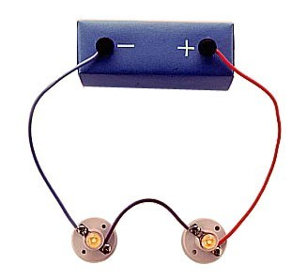
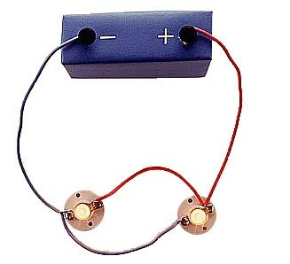
types of circuit
There are two types of electrical circuits;
SERIES CIRCUITS
PARALLEL CIRCUITS

Slide 4
The components are connected end-to-end, one after the other.
They make a simple loop for the current to flow round.
If one bulb ‘blows’ it breaks the whole circuit and all the bulbs go out.

Slide 5
The components are connected side by side.
The current has a choice of routes (paths).
If one bulb ‘blows’ there would still be a complete circuit to the other bulb so it stays lit.

Slide 6
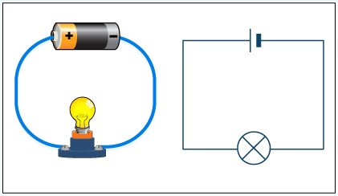
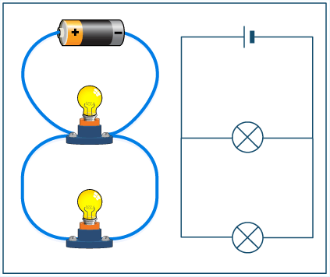
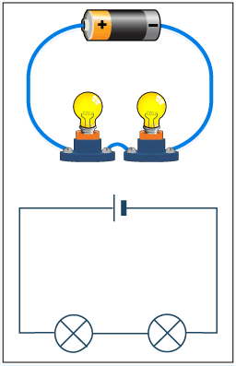
SERIES CIRCUIT
PARALLEL
CIRCUIT
Wires need to be drawn with a ruler and must not cross each other.

Slide 7
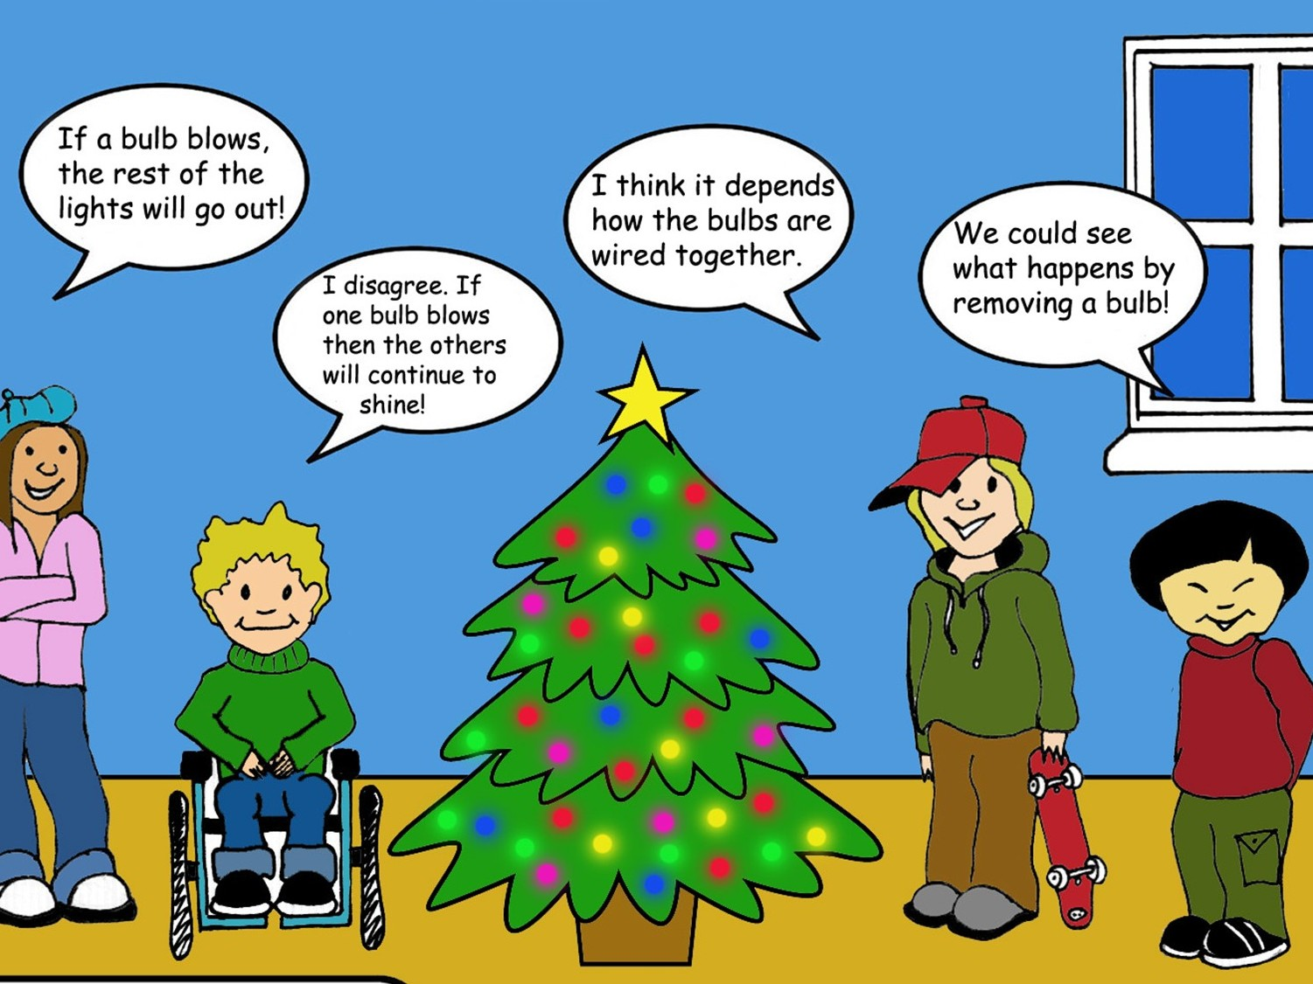

Slide 8


SERIES OR PARALLEL?
Would it be better to have the lights on a Christmas tree in series or parallel? Why?
Are the lights in your house connected up in series or parallel? How can you tell?

Slide 9
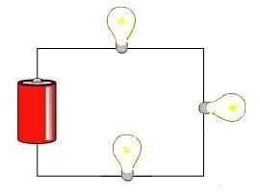
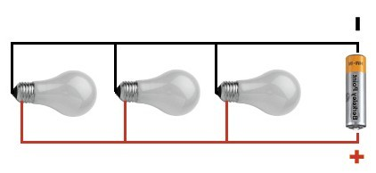
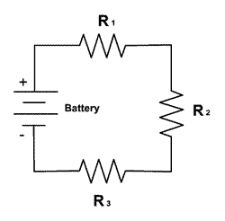
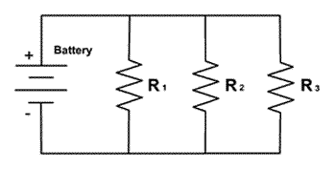
SERIES VS PARALLEL CIRCUITS
Series Circuit Paral el Circuit
Electrons only have one • path to flow through.
There are MULTIPLE paths for the current to flow through.

Slide 10
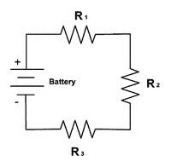
When^{S}e^{E}le^{R}ct^{I}ro^{E}ns^{S}ha^{C}ve^{IR}to^{C}flo^{U}w^{I}th^{T}rough one part to get to the next part
More components = more resistance
Increase resistance = decrease current (flow)
Less current = less bright bulbs
As voltage increases, current increases

Slide 11
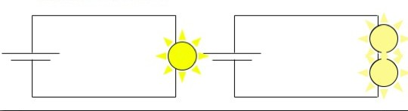
SERIES CIRCUIT – PROS & CONS
Problems with Series:
The more devices (resistors) in a series circuit, the less current passes through (dimmer bulbs).
If one resistor breaks (a bulb goes out) the entire series is turned off.

Slide 12
SERIES CIRCUIT - RESISTANCE
Resistors – resists the flow of electrical current
Increased resistance will reduce the rate at which charge flows (aka current)
Total resistance goes UP with each resistor since the current has must go through each resistor.
Total Resistance = Sum of all resistors in the series
R_{eq} = R₁+R₂+ R₃…

Slide 13
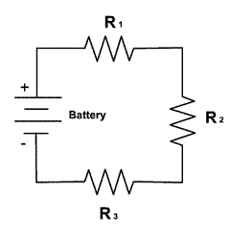
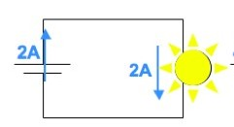
SERIES CIRCUIT - CURRENT
Current = amount of charge (flow of electrons)
  Like the flow of water
A current can't just disappear (appear)
  Since only one path if some electrons flow through R1, then they have to continue flowing through R2 and R3.
Since the Current is the same
I_{T}=I₁=I₂=I₃
through the entire c
ircuit

Slide 14
SERIES CIRCUIT - VOLTAGE
Voltage is the electric equivalent of water pressure.
  The higher the voltage, the faster electrons will flow through the conductor.
Each component has resistance that causes a drop in voltage (reduction in voltage).
Total Voltage = The sum of voltages across each series resistors
V_{T} = V₁ + V₂ + V₃…

Slide 15
SERIES VS PARALLEL CHART
Series Paral el
Voltage (V)
V_{tot} = V₁ + V₂ + V₃…
Current (I)
I_{tot}=I₁=I₂=I₃
Resistance (R)
R_{eq} = R₁+R₂+ R₃…

Slide 16
Series Circuit - Example
Given
– ^{V}battery ^{= 12 V}
– R₁ = 50 Ω, R₂ = 100 Ω, R₃ = 100 Ω
Complete the following table
V = I R
1
2
3
----------------------------------------------- T

Slide 17
PARALLEL CIRCUIT – PROS AND CONS
Advantages
The more devices (resistors) in a parallel circuit, does not decrease the current (does not dim bulbs).
If one resistor breaks (a bulb goes out) the rest do not.
Problems
Current doesn’t stay the same for entire circuit
  So energy is used up quicker
  So the total current increases = faster electrons = hotter wire = fire?

Slide 18
WHICH IS BETTER? SERIES OR PARALLEL?
Paral el
Most things are wired in parallel
Because of the fact that the more you plug in, the intensity doesn’t decrease.
Of course, this also increases the risk of fire
This is why homes have fuses or circuit breakers. They turn off everything in the circuit when current moves too fast.

Slide 19
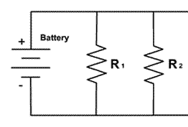
Parallel Circuit - Resistance
Resistors added side-by-side
The more paths, the less TOTAL resistance.
1/ R_{eq}=1/R₁+1/R₂+1/R₃
Ex. 2 resistors in parallel with 4Ω each.
  Since the circuit offers two equal pathways for charge flow, only 1/2 the charge
will choose to pass through a given branch.

Slide 20
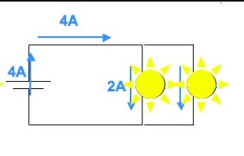
PARALLEL CIRCUIT - CURRENT
ALL paths are used!
  But the charge d iv id e s up into all branches
  One branch can have more current than another branch (depends on resistance in branch).
Total current = sum of current in each path
I_{T} = I₁ + I₂ + …

Slide 21
Parallel Circuit - Voltage
A charge only passes through a single resistor.
Voltage drop across the resistor that
it chooses to pass through must equal the voltage of the battery.
Total voltage = the voltage across each individual resistor
V_{T} = V₁ = V₂ = …

Slide 22
SERIES VS PARALLEL CHART
Series Paral el
Voltage (V)
V_{tot} = V₁ + V₂ + V₃…
V_{tot} = V₁ = V₂ = …
Cur ent (I)
I_{tot}=I₁=I₂=I₃
I_{tot} = I₁ + I₂ + …
Resistance (R)
R_{eq} = R₁+R₂+ R₃…
1/R_{eq}=1/R₁+1/R₂+1/R₃

Slide 23
Parallel Circuit - Example
Given
– ^{V}battery ^{= 12 V}
– R₁ = 50 Ω, R₂ = 100 Ω, R₃ = 100 Ω
Complete the following table:
V = I R
1
2
3
----------------------------------------------- T

Slide 24
measuring current & voltage
a)
6V
4A
A
V
V
A

Slide 25
measuring current & voltage
b)
6V
4A
A
V
A
V
A

Slide 26
answers
a)
b)
6V
6V
4A
4A
6V
4A
4A
3V
3V
2A
4A
6V
2A

Slide 27
TWO TYPES OF
CURRENT
DC—Direct Current
  produced by solar cells and chemical cells (batteries)
  Current only flows in one direction.
AC—Alternating Current
  Current flows back and forth (alternates)
  Found in homes
  Generators produce AC current

