Slide 1


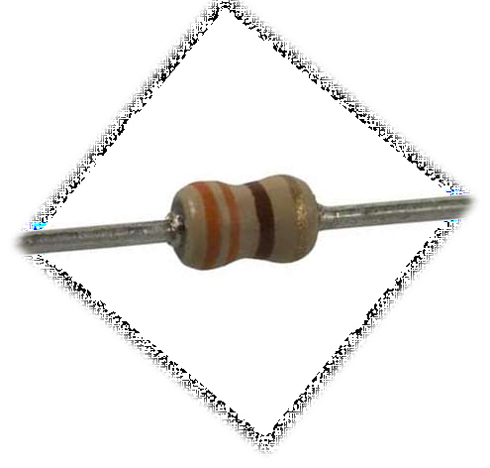


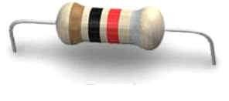

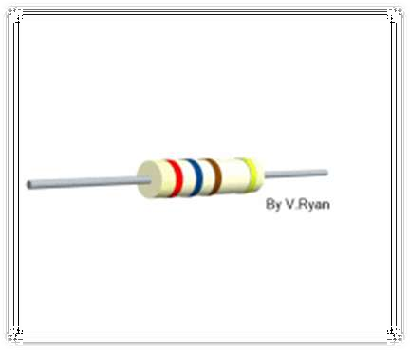
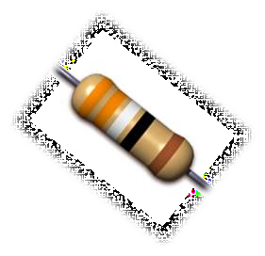

Slide 2

WHAT IS RESISTOR ?
TYPES OF RESISTOR.
CONNECTION OF RESISTOR.
RESISTOR COLOUR CODE
RESISTOR POWER RATING

Slide 3

A RESISTOR IS A PASSIVE TWO - TERMINAL ELECTRICAL COMPONENT THAT IMPLEMENTS ELECTRICAL RESISTANCE AS A CIRCUIT ELEMENT.
THE RATIO OF THE VOLTAGE APPLIED ACROSS A RESISTOR'S TERMINALS TO THE INTENSITY OF CURRENT THROUGH THE CIRCUIT IS CALLED RESISTANCE.
THIS RELATION IS REPRESENTED BY OHM'S
LAW:
V = I R

Slide 4




UNIT SYMBOL
THE OHM (SYMBOL: Ω) IS THE SI UNIT
OF ELECTRICAL RESISTANCE, NAMED AFTER GEORG SIMON OHM.
AN OHM IS EQUIVALENT TO A VOLT PER AMPERE
OTHER DERIVED UNITS ARE MILLI OHM (1 MΩ =
10⁻³ Ω), KILO OHM (1 KΩ = 10³ Ω), AND MEGA OHM (1 MΩ
= 10⁶ Ω).
FIXED RESISTOR
VARIABLE RESISTOR

Slide 5
TYPES OF RESISTOR

Slide 6





TYPES OF RESISTOR
RESISTOR
FIXED RESISTOR
VARIABLE RESISTOR

Slide 7
VARIABLE RESISTOR
FIXED RESISTOR
CARBON COMPOSITE RESISTOR
RHEOSTAT
POTENTIOMETER
THERMISTOR
HUMISTOR
VARISTOR
PHOTORESISTOR
FILM RESISTOR
WIRE WOUND RESISTOR
RESISTANCE WIRE

Slide 8
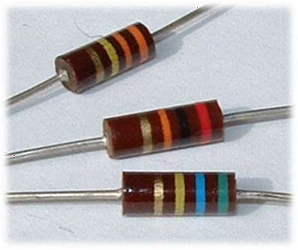

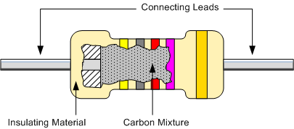
CARBON COMPOSITE RESISTOR
LOW INDUCTANCE
IDEAL FOR HIGH FREQUENCY APPLICATIONS
VERY CHEAP TO MAKE
HAVE VERY LARGE TOLERANCES

Slide 9

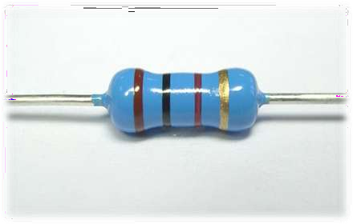

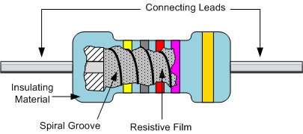
FILM RESISTOR
THE RESISTIVE VALUE OF THE RESISTOR IS CONTROLLED BY INCREASING THE DESIRED THICKNESS OF THE DEPOSITED FILM.
RESISTANE UPTO 10MΩ CAN BE OBTAINED.
HAVE TOLERANCE 1% OR LESS

Slide 10
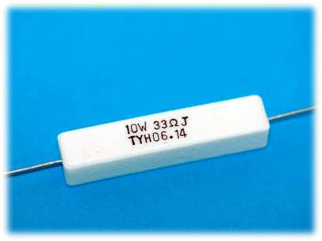

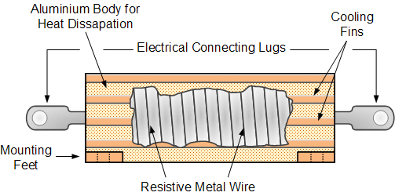
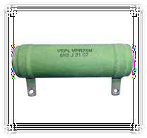
WIRE WOUND RESISTOR
MADE BY WINDING A THIN METAL ALLOY WIRE ONTO AN INSULATING CERAMIC FORMER IN THE FORM OF A SPIRAL HELIX
AVAILABLE IN VERY LOW OHMIC AND HIGH PRECISION VALUES
(FROM 0.01 TO 100KΩ)

Slide 11
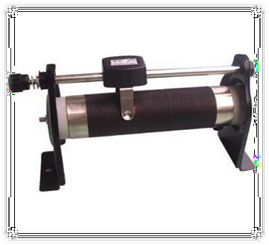

RHEOSTAT
RHEOSTAT IS A ADJUSTABLE RESISTOR USED IN APPLICATIONS THAT REQUIRE ADJUSTMENT OF CURRENT OR VARYING OF RESISTANCE IN
AN ELECTRIC CIRCUIT
A SPECIAL TYPE OF RHEOSTAT IS THE POTENTIOMETER

Slide 12

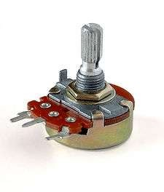
POTENTIOMETER
A POTENTIOMETER IS, A POT, IN ELECTRONICS TECHNOLOGY IS A THREE-TERMINAL RESISTOR WITH A SLIDING CONTACT THAT FORMS AN ADJUSTABLE VOLTAGE DIVIDER.
POTENTIOMETERS ARE COMMONLY USED TO CONTROL ELECTRICAL DEVICES SUCH AS VOLUME CONTROLS, JOYSTICKS ETC.

Slide 13

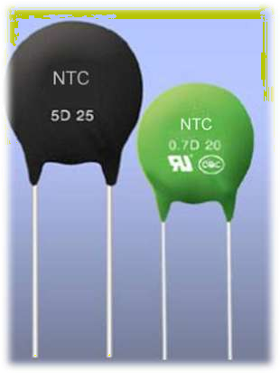

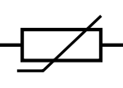
THERMISTOR
A THERMISTOR IS A TYPE
OF RESISTOR WHOSE RESISTANCE VARIES SIGNIFICANTLY
WITH TEMPERATURE
THERMISTORS CAN BE USED AS CURRENT-LIMITING DEVICES FOR CIRCUIT PROTECTION, AS REPLACEMENTS FOR FUSES

Slide 14

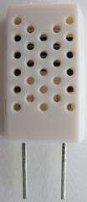
HUMISTOR
A HUMISTOR IS A TYPE
OF RESISTOR WHOSE RESISTANCE VARIES SIGNIFICANTLY
WITH HUMIDITY
A HUMIDITY SENSOR MEASURES THE HUMIDITY LEVEL BY MEASURING THE CHANGE IN
THE RESISTANCE OF AN ELEMENT

Slide 15

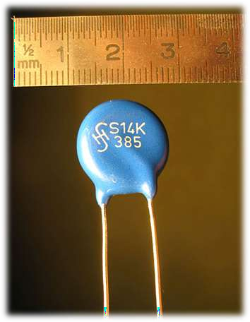
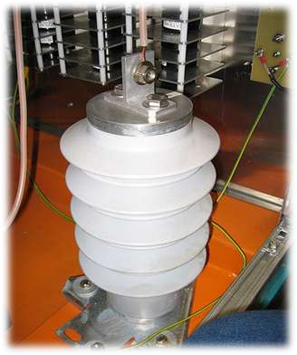
VARISTOR
A VARISTOR (OR VOLTAGE DEPENDENT RESISTOR ) FUNCTION IS TO CONDUCT SIGNIFICANTLY INCREASED CURRENT WHEN VOLTAGE IS EXCESSIVE.
HIGH VOLTAGE VARISTOR

Slide 16

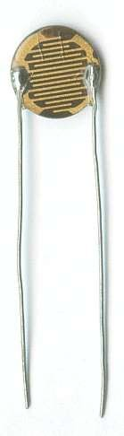
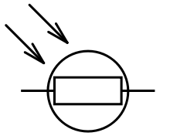
PHOTORESISTOR
A PHOTORESISTOR OR LIGHT DEPENDENT RESISTOR (LDR) EXHIBITS PHOTOCONDUCTIVITY.
PHOTORESISTORS IN MANY CONSUMER ITEMS SUCH AS STREET LIGHTS, CLOCK RADIOS, ALARM DEVICES ETC

Slide 17
CONNECTION OF RESISTORS

Slide 18

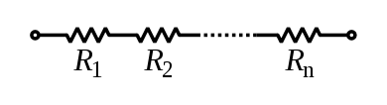
SERIES CONNECTION
IN SERIES CONNECTION, THE CURRENT REMAINS CONSTANT.
(i.e. I = I₁ = I₂ = …. = I_{n} )
IN SERIES CONNECTION, VOLTAGE ADDS UP. (i.e. V = V₁ + V₂ + …. + V_{n})

Slide 19

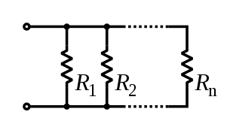

PARALLEL CONNECTION
IN PARALLEL CONNECTION, THE VOLTAGE REMAINS CONSTANT.
(i.e. V = V₁ = V₂ = …. = V_{n})
IN PARALLEL CONNECTION, CURRENT ADDS UP.
(i.e. I = I₁ + I₂ + …. + I_{n} )

Slide 20

RESISTOR COLOUR CODE

Slide 21

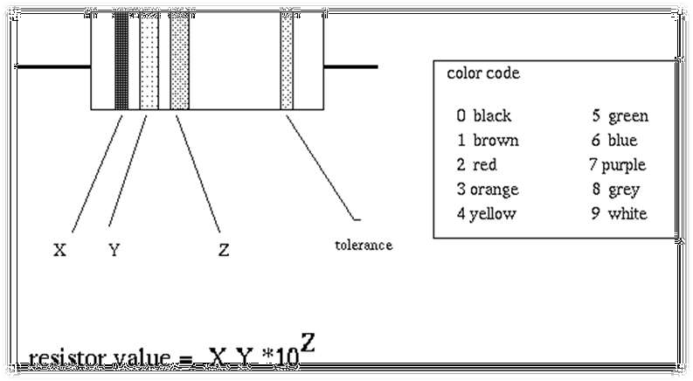

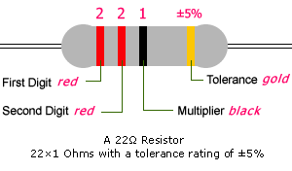


RESISTOR VALUE = XY * Z ± TOLERANCE
EXAMPLE:-
FIND THE RESISTANCE OF THE GIVEN RESISTOR ?

Slide 22

COLOUR CODE TABLE
COLOUR | DIGIT | MULTIPLIER | TOLERANCE
BLACK | 0 | 10⁰ | -
BROWN | 1 | 10¹ | ± 1%
RED | 2 | 10² | ± 2%
ORANGE | 3 | 10³ | -
YELLOW | 4 | 10⁴ | -
GREEN | 5 | 10⁵ | ± 0.5%
BLUE | 6 | 10⁶ | ± 0.25%
VIOLET | 7 | 10⁷ | ± 0.1%
GREY | 8 | 10⁸ | -
WHITE | 9 | 10⁹ | -
GOLD | - | ₁₀-1 | ± 5%
SILVER | - | ₁₀-2 | ± 10%
NONE | - | - | ± 15%

Slide 23
POWER RATING

Slide 24


RESISTOR POWER RATING
THE POWER RATING OF RESISTORS CAN BE CALCULATED USING THE FORMULA :-
THE LARGER THE POWER RATING, THE GREATER THE PHYSICAL SIZE OF THE RESISTOR.
WHEN USED IN AC CIRCUITS THE AC IMPEDANCE OF A RESISTOR IS EQUAL TO ITS DC RESISTANCE.

Slide 25



CITATION
www.google.com
en.wikipedia.org
www.electronics-tutorials.ws

Slide 26



