Slide 1
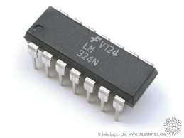
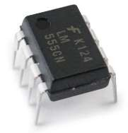
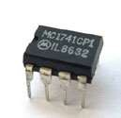
INTEGRATED CIRCUITS
1

Slide 2




INTEGRATED CIRCUITS
In electronics, an integrated circuit is a miniaturized electronic circuit (semiconductor devices, as well as passive components) that has been manufactured in the surface of a thin substrate of semiconductor material.
Integrated circuits are used in almost all electronic equipment in use today and have revolutionized the world of electronics.
2

Slide 3


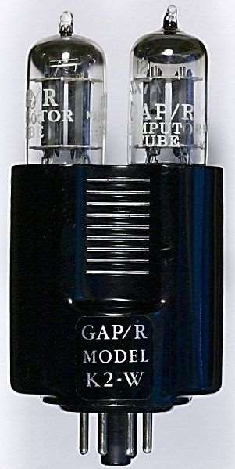















History
First op amps built in 1930’s-1940’s
  Technically feedback amplifiers due to only having one useable input
Used in WW-II to help how to strike military targets
  Buffers, summers, differentiators, inverters
Took ±300V to ± 100V to power
3
http://en.wikipedia.org/wiki/Image:K2-w_vaccuum_tube_op-amp.jpg1

Slide 4

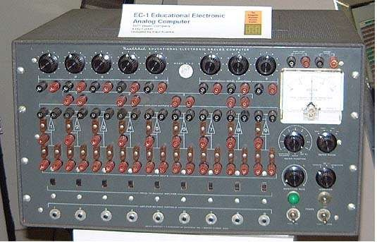







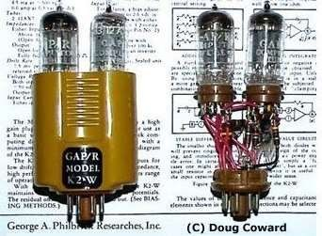




History
Analog Computer
Vacuum Tube Era, 1950s
1st used in Analog Computers
  Addition
  Subtraction
  Integration
  Differentiation
Heavy
$$$
Prone to failure
K2-W tubes general purpose Op-Amp. 1952
4

Slide 5
















IC Fabrication Technology: Brief History
1940s - setting the stage - the initial inventions that made integrated circuits possible.
In 1945, Bell Labs established a group to develop a
semiconductor replacement for the vacuum tube. The group
led by William Shockley, included, John Bardeen, Walter Brattain and others.
In 1947 Bardeen and Brattain and Shockley succeeded in
creating an amplifying circuit utilizing a point-contact "transfer resistance" device that later became known as a transistor.
In 1951 Shockley developed the junction transistor, a more
practical form of the transistor.
By 1954 the transistor was an essential component of the telephone system and the transistor first appeared in hearing aids followed by radios.
5

Slide 6


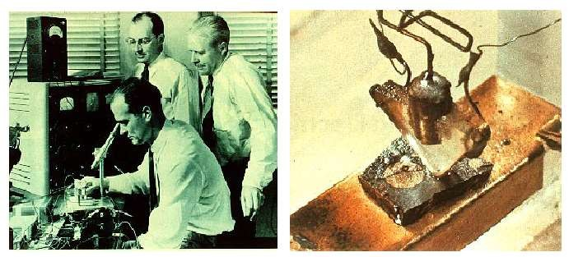
The transistor invented at Bell lab. in 1947
In 1956 the importance of the invention of the transistor by Bardeen, Brattain and Shockley was recognized by the Nobel Prize in physics.
6

Slide 7












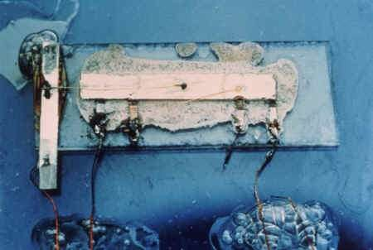
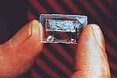
Sept¹e⁹m⁵be⁸r ⁻12^{I}th^{n}1^{t}9e5^{g}8^{r}Jªa^{t}c^{e}k ^{d}Kilb^{c}y^{ir}a^{c}t ^{u}Te^{i}x^{t}a^{i}s^{n}in^{v}st^{e}r^{n}um^{te}en^{d}t had
built a simple oscillator IC with five integrated components
(resistors, capacitors, distributed capacitors and transistors)
In 2000 the importance of the IC was recognized when Kilby shared the Nobel prize in physics with two others.
Kilby was sited by the Nobel committee "for his part in the invention of the integrated circuit ”
8

Slide 8








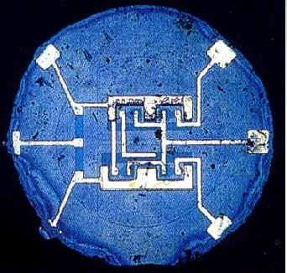













1959 - Planar technology invented
Kilby's invention had a serious drawback, the individual circuit
elements were connected
together with gold wires
making the circuit difficult to scale up to any complexity.
The metal layer connected
down to the junctions through the holes in the silicon dioxide and was then etched into a pattern to interconnect the
circuit. Planar technology set
Planar technology
the stage for complex integrated circuits and is the process used today.
9
Lecture #1

Slide 9











ADVANTAGES OF IC’S
SMALL SIZE
LOW COST
IMPROVED PERFORMANCE
HIGH RELIABILITY AND RUGGEDNESS
LOW POWER CONSUMPTION
LESS AFFECTED TO PARAMETER VARIATION
EASY TROUBLESHOOTING
INCREASED OPERATING SPEED
LESS WEIGHT,VOLUME
EASY REPLACEMENT

Slide 10








DISADVANTAGES OF IC’S
AS IC IS SMALL IN SIZE ITS UNABLE TO DISSIPATE LARGE AMOUNT OF POWER. INCREASE IN CURRENT MAY PRODUCE ENOUGH HEAT WHICH MAY DESTROY THE DEVICE.
AT PRESENT COILS, INDUCTORS AND TRANSFORMERS CAN NOT BE PRODUCED IN IC FORM.

Slide 11







CLASSIFICATION OF IC’S
On the basis of fabrication techniques used
On the basis of the chip size On the basis of applications

Slide 12






ON BASIS OF FABRICATION
Monolithic IC’s
Hybrid or Multi-chip ICs.
Thin and Thick Film IC’s.

Slide 13

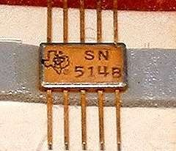
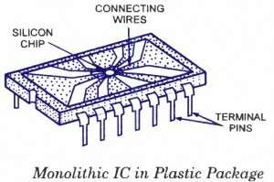
MONOLITHIC IC’S
Monolithic circuit is built into a single stone or single crystal i.e. in monolithic ICs, all circuit components, and their interconnections are formed into or on the top of a single chip of silicon. Monolithic ICs are by far the most common type of ICs used in practice, because of mass production , lower cost and higher reliability.

Slide 14

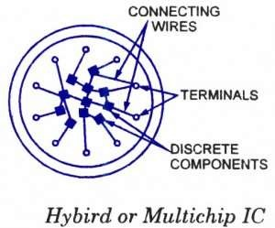
HYBRID IC’S
The circuit is fabricated by interconnecting a number of individual chips.
Hybrids ICs are widely used for high
power audio amplifier applications .
Have better performance than monolithic ICs
Process is too expensive for mass production

Slide 15

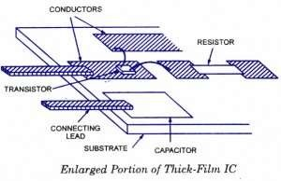
THIN AND THICK FILM IC’S
These devices are larger than monolithic ICs but smaller than discrete circuits. These ICs can be used when power requirement is
comparatively higher.
With a thin-or thick-film IC, the passive components like resistors and capacitors are integrated, but the transistors and diodes are connected as discrete components to form a complete circuit.

Slide 16

THIN AND THICK FILM IC’S
The essential difference between the thin- and thick- film ICs is not their relative thickness but the method of deposition of film.
In thick film type the resistors and interconnection patterns are printed on a ceramic substrate.
In thin film type the resistors and interconnection patterns are deposited by vacuum evaporation technique on a glass or glazed ceramic substrate.
Both have similar appearance, properties and general characteristics.

Slide 17

ON BASIS OF CHIP SIZE
SSI (small-scale integration)
MSI (medium-scale integration) LSI (large-scale integration)
VLSI (very large-scale integration) ULSI (ultra large-scale integration)

Slide 18

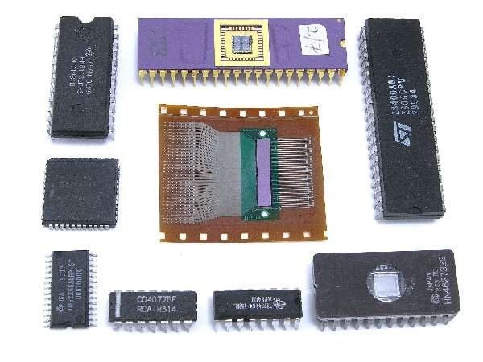
SSI AND MSI
Small scale integration (SSI) has 3 to 30 gates/chip or Up to 100 electronic components per chip
Medium scale integration (MSI) has 30 to 300 gates/chip or
100 to 3,000 electronic components per chip

Slide 19

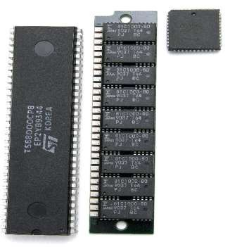
LSI AND VLSI
Large scale integration (LSI)-300 to 3,000 gates/chip or 3,000 to 100,000 electronic components per chip.
Very large scale integration (VLSI)- more than 3,000 gates/chip or 100,000 to 1,000,000 electronic components per chip

Slide 20

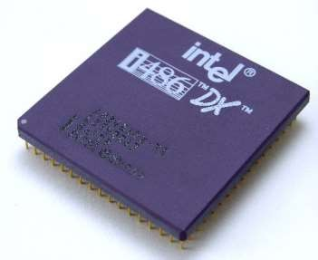
ULSI
Ultra Large-Scale Integration (ULSI)- More than 1 million electronic components per chip
The Intel 486 and Pentium microprocessors, for example, use ULSI technology. The line between VLSI and ULSI is vague.

Slide 21



ON BASIS OF APPLICATIONS
LINEAR INTEGRATED CIRCUITS
DIGITAL INTEGRATED CIRCUITS

Slide 22



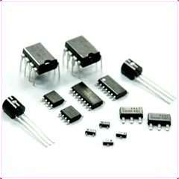








LINEAR INTEGRATED CIRCUITS
When the input and output relationship of a circuit is linear, linear ICs are used. Input and output can take place on a continuous range of values.
Example operational amplifiers, power amplifiers, microwave amplifiers multipliers etc.

Slide 23

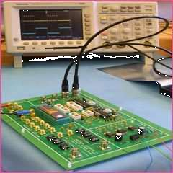
DIGITAL INTEGRATED CIRCUITS
When the circuit is either in on-state or off-state and not in between the two, the circuit is called the digital circuit. ICs used in such circuits are called the digital ICs. They find wide applications in computers and logic circuits.
Example logic gates, flip flops, counters, microprocessors, memory chips etc.

