Slide 1

Household Wiring
.

Slide 2
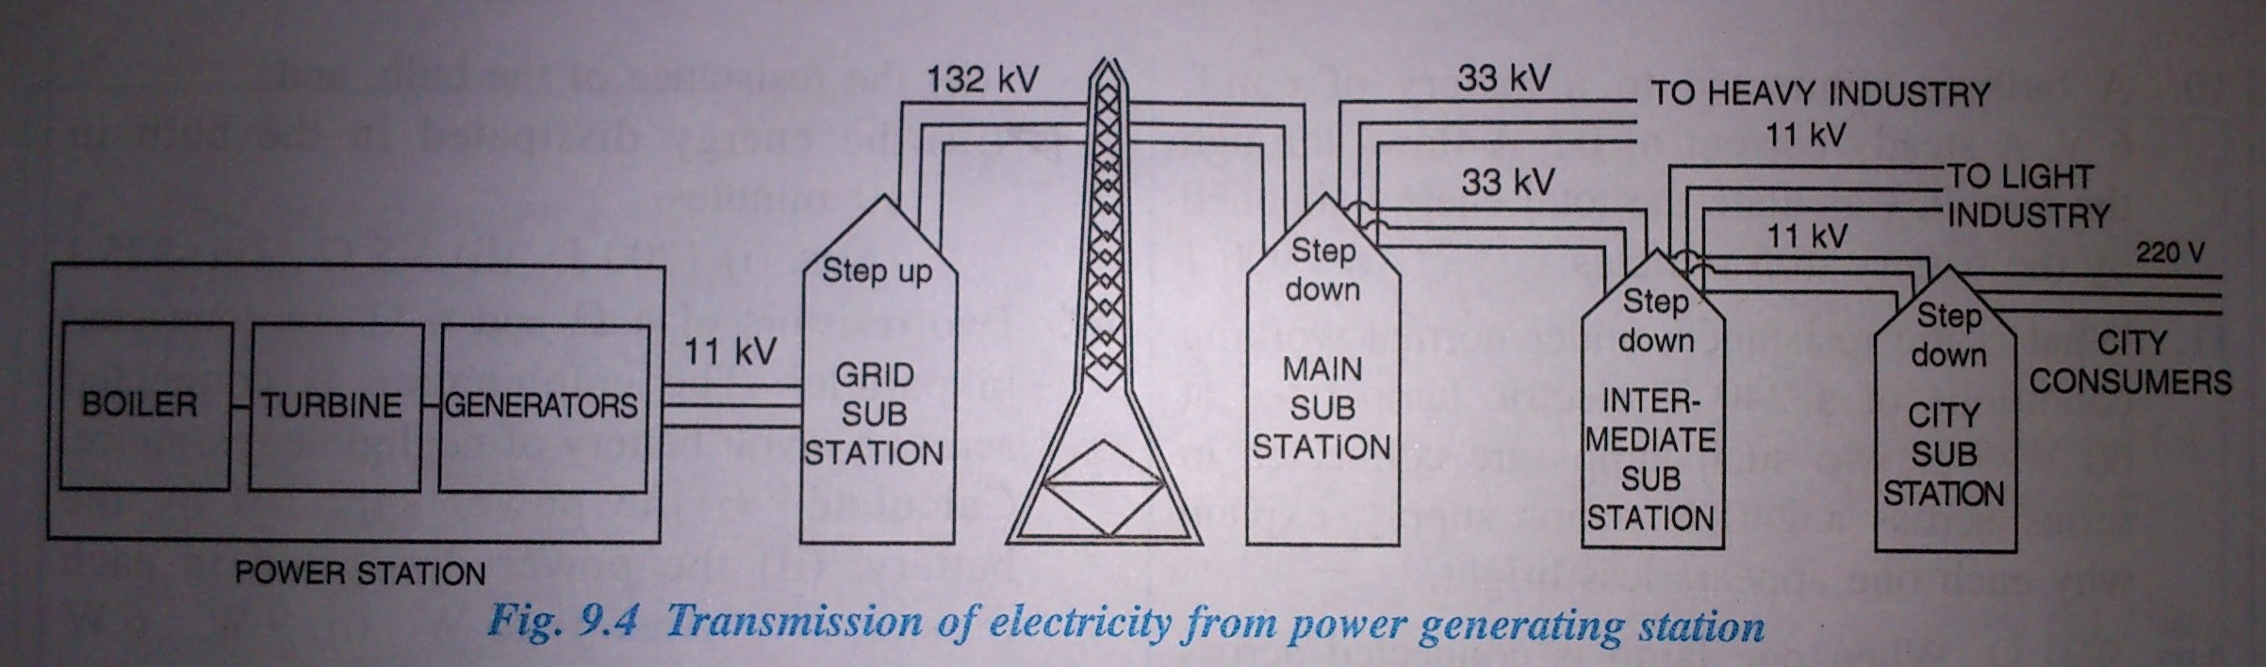
Transmission of power from the generating station
Concise Physics (2012 edition)

Slide 3
Why is the rating of transformer like 11kv, 132kv,33kv, 66kv?
Because the tranformer calculation for ratings is calculated with the form factor which is 1.11 constant.
http://www.electricaltechnology.org/

Slide 4
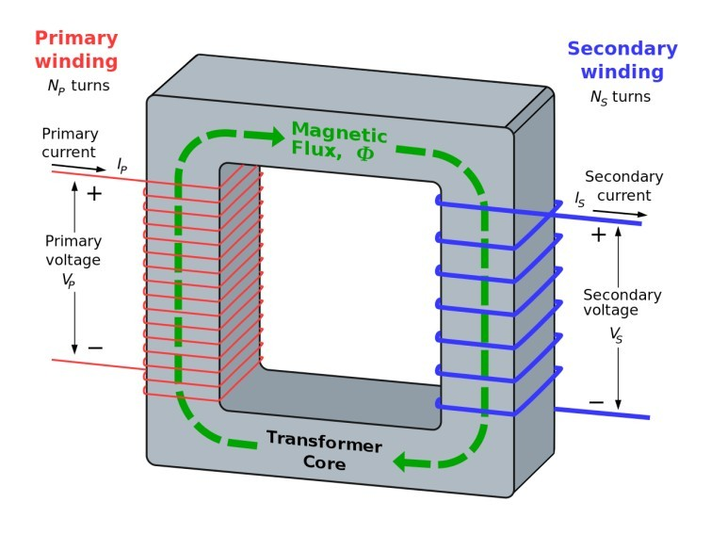
TRANSFORMER

Slide 5
Why 220V ?
Because the cost per unit is cheaper at the higher voltage.
If you were supplied at 330kV, then it would be cheaper still , but require much larger infrastructure

Slide 6
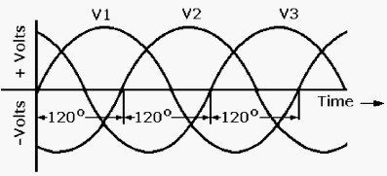
Single Phase and Three Phase Connections
•
Single-phase supply - a single alternating current in supplied through a single wire
– 220 V ( AC ) at 50 Hz (In India)
•
Three-phase system - 3 wires carry alternating current with a definite phase difference
– 415 V ( AC )
•
Difference -three-phase connection can handle heavy load while a single-phase cannot.
https://www.bijlibachao.com/electricity-bill/what-are-single-phase-and-three-phase- connections-and-how-to-choose-between-the-two.html
http://guardianstabilisers.com/?q=node/25

Slide 7
HOUSE WIRING
It is wiring or electrical system used in home or surrounding ares.
is time consuming
requires planning
need to ensure safety and code

Slide 8
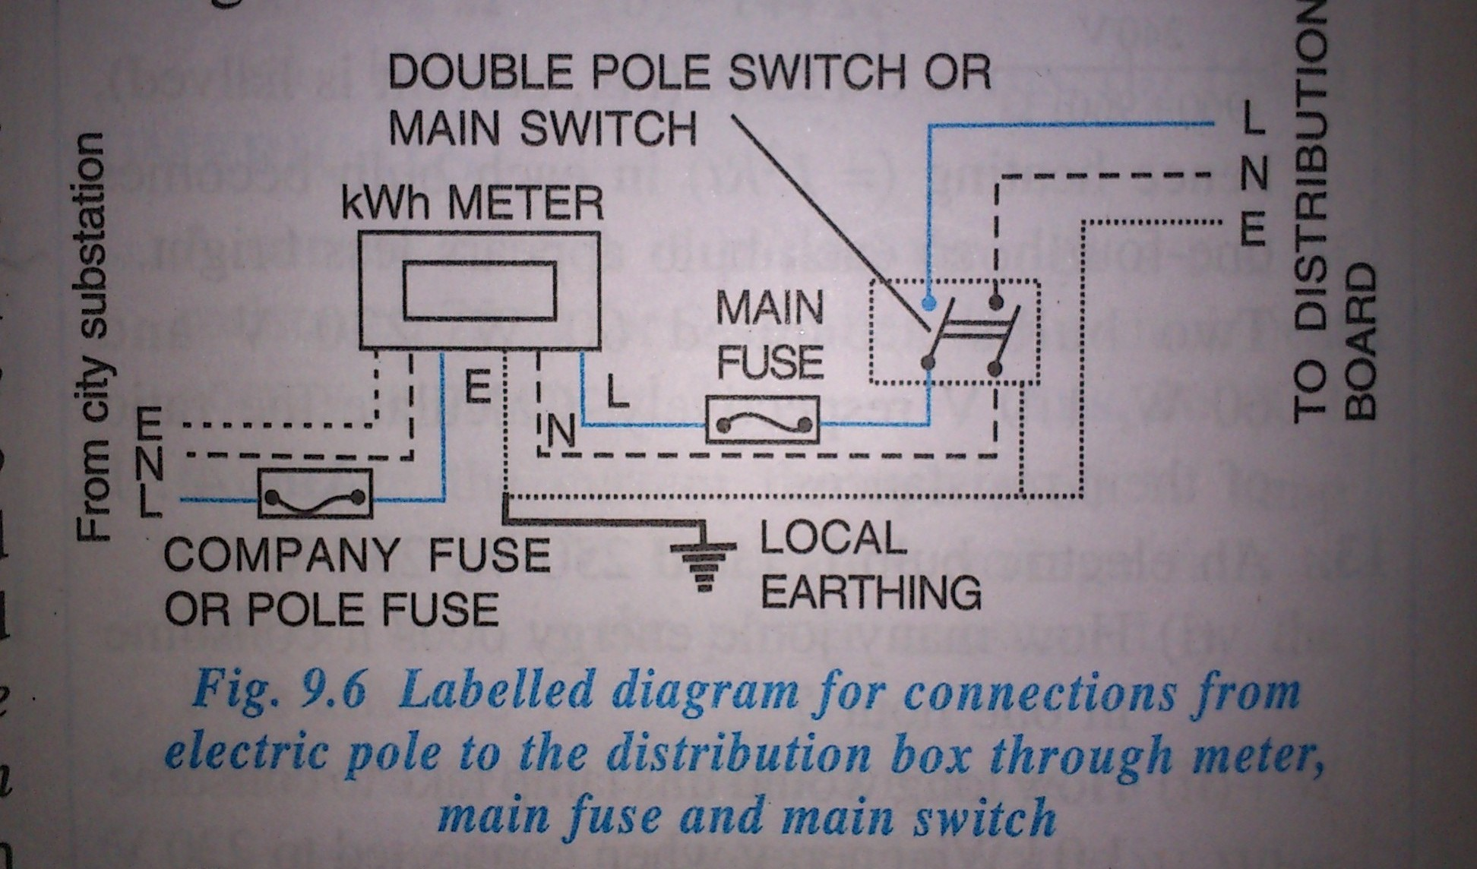
Power Distribution to a house
Concise Physics (2012 edition)

Slide 9
Wiri
•
Wire colors
Black (light blue now)
Red (brown now)
White/green (green or yellow now).
•
The black and the red wires are “hot”
Black wire
negative 120V from the neutral
Red wire
positive 120V from the neutral
•
The white wire is neutral
– leading to a ground

Slide 10
Neutral and Earth wire are connected at 0V
Live wire - current to distribution box.
Neutral wire is for the return path.

Slide 11
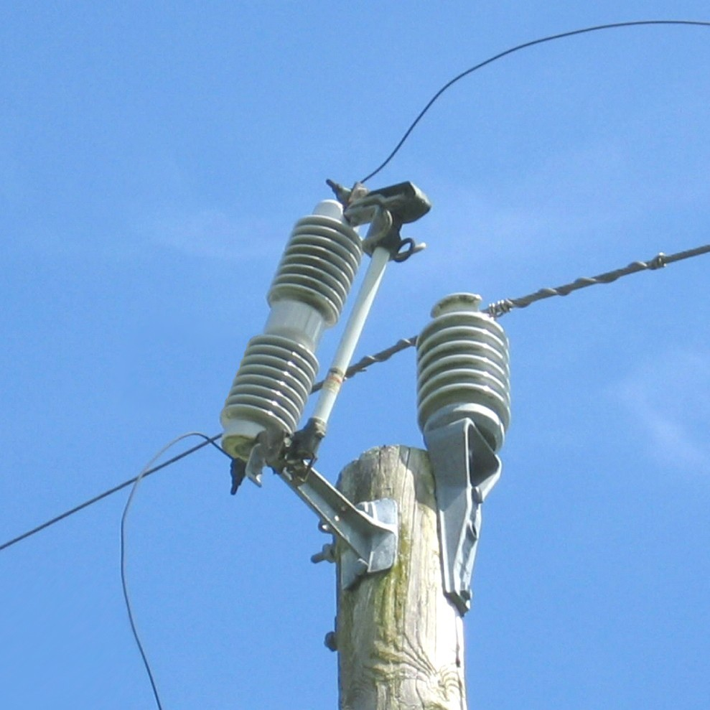
COMPANY FUSE
A fuse of high rating (≈50A) is connected in the live wire at the pole or just before the meter.
This fuse is called the company fuse or pole fuse.

Slide 12
After company fuse, the cable is connected to a kWh meter.
From meter the connections are made with the distribution board through main fuse and a main switch.

Slide 13
Main switch is a double pole switch.
It has an iron covering which is earthed.

Slide 14
THREAD ACTIVITY

Slide 15
Types of house wiring
Tree System
Ring System

Slide 16
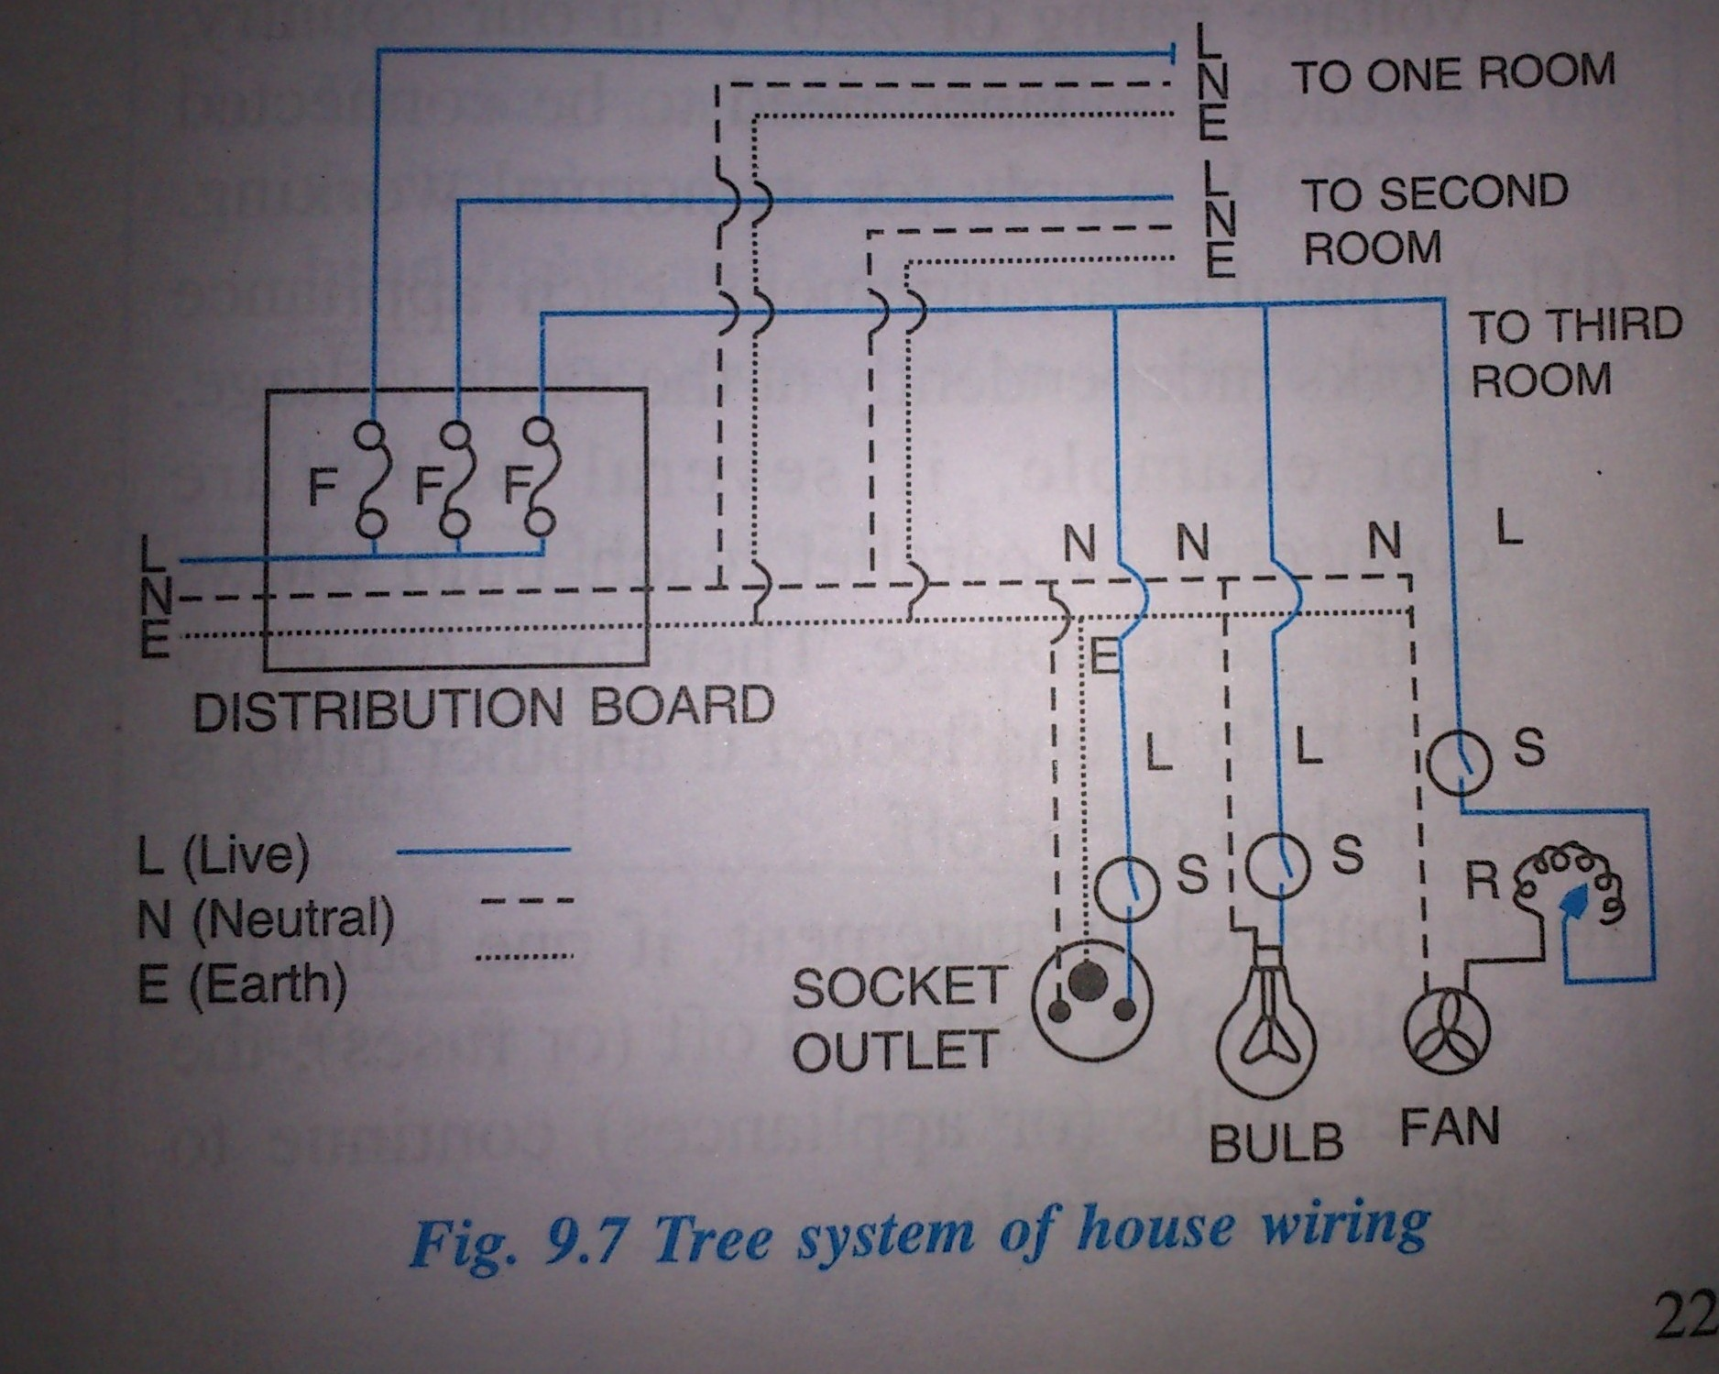

TREE SYSTEM
Concise Physics (2012 edition)

Slide 17
Each branch to a room through a fuse in the live wire.
No. of distribution circuits from distribution board depends on the total power consumption
Concise Physics (2012 edition)

Slide 18
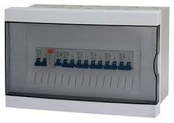
THE DISTRIBUTION BOARD

Slide 19
The total load of all the circuits together must not exceed the specified value
The different connection are connected in
parallel at the distribution board
Concise Physics (2012 edition)

Slide 20
Balloon activity

Slide 21
Line wires used of proper current carrying capacity depending on the rating of the appliance
The overheating often results in a fire.
The switches and sockets used for different appliances should have the proper current carrying capacities.
Concise Physics (2012 edition)

Slide 22
Disadvantages of tree system
It requires plugs and sockets of different sizes
When the fuse in one distribution line blows, it disconnects all the appliances from the supply line in that distribution circuit.
The wiring is expensive.
If a new appliance is to be installed requiring higher current, then it is necessary to put the new line wires from the appliance to the distribution box.
Concise Physics (2012 edition)

Slide 23
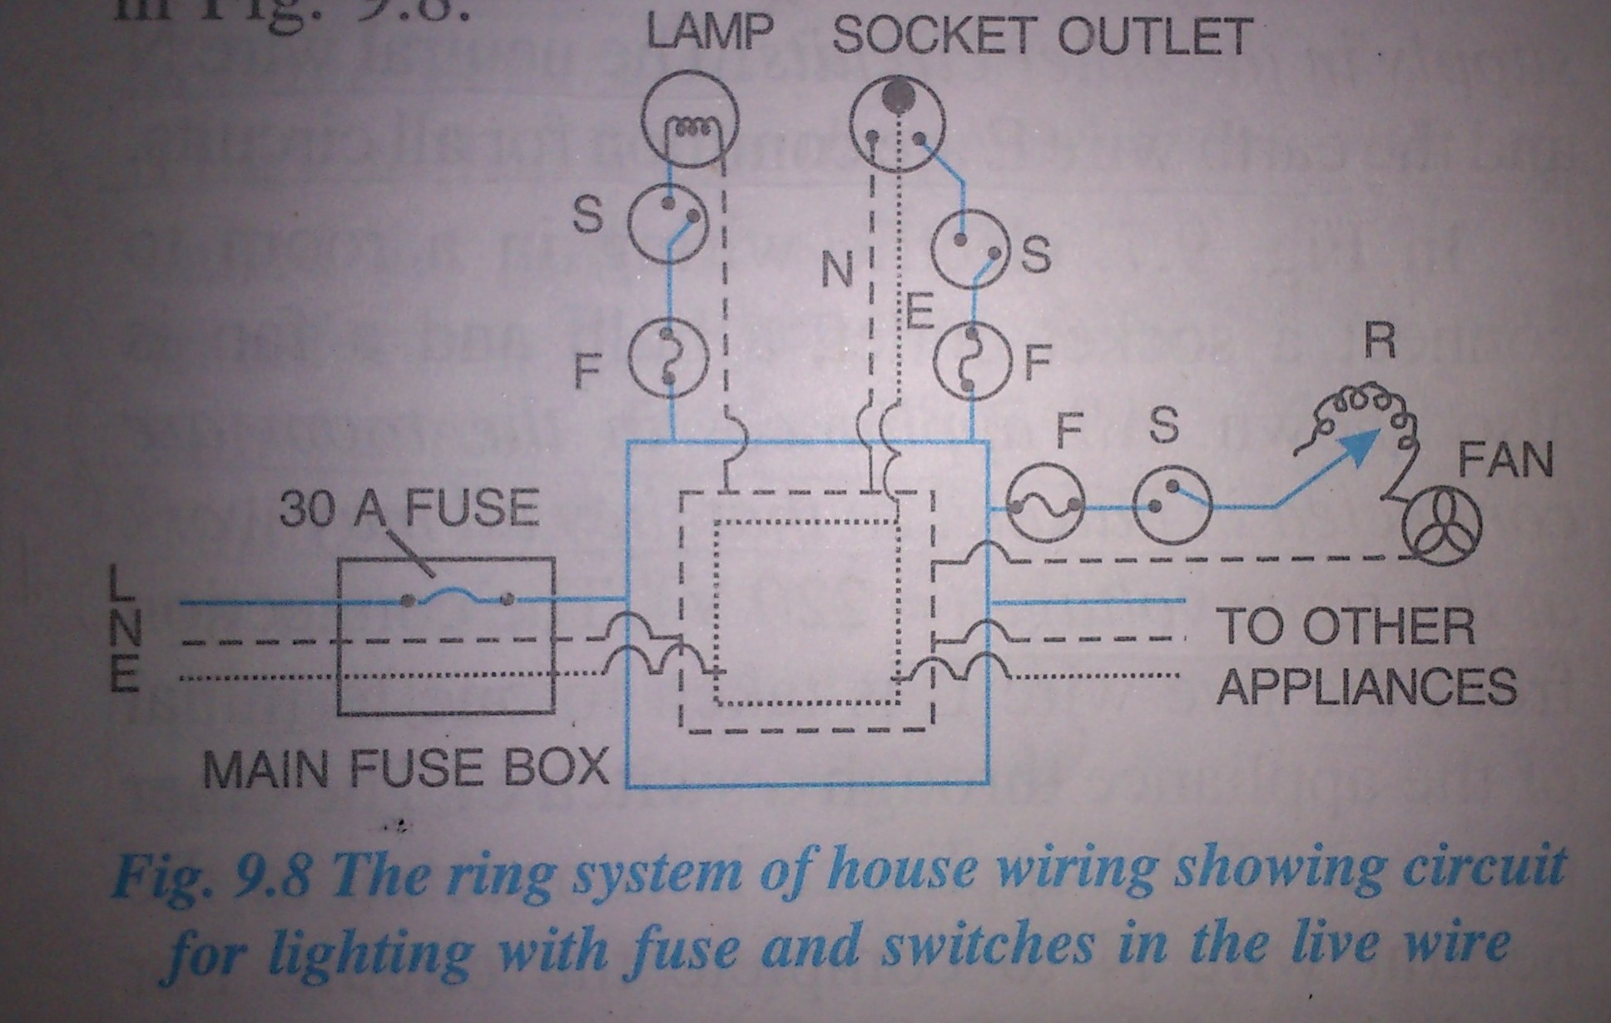
RING SYSTEM
Concise Physics (2012 edition)

Slide 24
New system
Wires from the main fuse box run around all the main rooms of the house and then come back to the fuse box again.
The fuse box contains a fuse rating of 30A.
Separate connection from live wire of the ring for each appliance.
Concise Physics (2012 edition)

Slide 25
One terminal of the appliance is connected to the live wire through a separate fuse and a separate switch
The other terminal to the neutral wire.
The earth terminal or the metal covering of the appliance is connected to the earth wire.
Concise Physics (2012 edition)

Slide 26

If the fuse of one appliance burns, it does not affect the other appliances.
For each appliance, the wires used for connection should be of proper current carrying capacity.
Concise Physics (2012 edition)

Slide 27
Advantages of ring system
In this system, the plugs and sockets all of the same size can be used
While installing a new appliance in a room, a new line up to the distribution box is not required.
Each appliance has a separate fuse.
Cheaper
Concise Physics (2012 edition)

Slide 28
Parallel over series
Same voltage
In parallel arrangement, if one bulb is switched off, the other bulbs continue to glow.
Concise Physics (2012 edition)

Slide 29

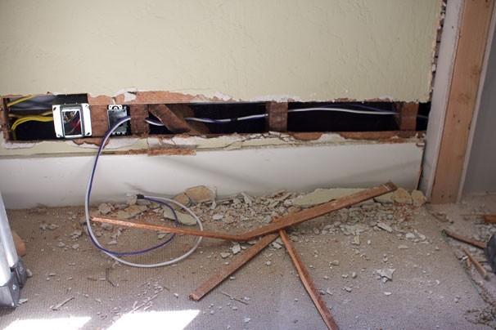
House Wiring Rules as Per ISI Specification
Distribution systems with main and branch distribution boards to convenient centers
All conductors should run along walls and ceilings
No wiring above ceiling.
Medium pressure wiring and all associated apparatus should comply with specification.
http://www.gharexpert.com/articles/Wiring-Electric-fitting-1803/Electrical-Fitting- Cable-Wiring_0.aspx

Slide 30
House Wiring Rules as Per ISI Specification
Total load ≦ 800 watts.
One circuit can be explained as one connection from electrical meter or main fuse circuit.
For power wiring circuit the numbers of points in a circuit should not be more than 2 and the size of wire is 1.5 mm square for copper and 2 mm square for aluminum.
http://www.gharexpert.com/articles/Wiring-Electric-fitting-1803/Electrical-Fitting- Cable-Wiring_0.aspx

Slide 31

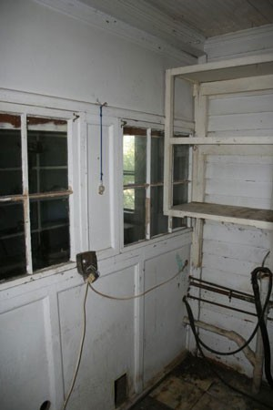
House Wiring Rules as Per ISI Specification
8. Switch boards - at a height of
1.5 meter.
Horizontal run of wiring - at a height of 3 meter.
Earth wire should be 14 SWG in case of copper and 4 mm square in case of aluminum.
http://www.gharexpert.com/articles/Wiring-Electric-fitting-1803/Electrical-Fitting- Cable-Wiring_0.aspx

Slide 32
House Wiring Rules as Per ISI Specification
11. All conductors -of copper and cross section ≦ 0.0020 sq. inches
12. Minimum size of earth wire for light circuit is 1 mm square for copper and 1.5 mm square for aluminum.
http://www.gharexpert.com/articles/Wiring-Electric-fitting-1803/Electrical-Fitting- Cable-Wiring_0.aspx

Slide 33
House Wiring Rules as Per ISI Specification
Fuse wire - connected to phase wire only.
Connect a neutral link in neutral wire. 15.Connect all switches in phase wire.
16.Never utilize damaged wiring or elements
http://www.gharexpert.com/articles/Wiring-Electric-fitting-1803/Electrical-Fitting- Cable-Wiring_0.aspx

Slide 34
ECONOMIC ASPECT
Approximate cost of house wiring
  Rs 50 - 100 per sqft for materials
  Rs 12 - 20 per sqft for labor
This excludes the cost of fans, lights, AC's, and
other appliances.
- Local Electrician

Slide 35
3 way switch VIDEO

Slide 36
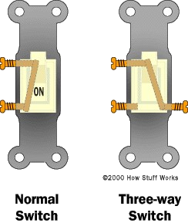
3 way switch
•
In building wiring, 3 way switching is the interconnection of two electric switches to control an electrical load from more than one location.
•
The controlled load maybe a lamp, fans, pumps, heaters, or other appliances.
http://en.wikipedia.org/wiki/Multiway_switching#Three-way_and_four-way

Slide 37
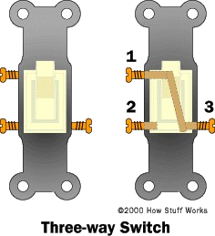
Three-way switch makes it possible to control a light from multiple locations
"3-way" switch is a SPDT switch.

Slide 38
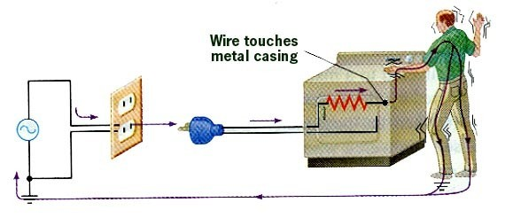
Improperly Grounded Appliance with Short
One milliampere: Ten milliamperes:
tingling sensation
nerves and muscles overloaded
200 milliamperes: potentially fatal; heart fibrillation
500 - 1000 milliamperes: not necessarily fatal; heart will restart -- One ampere or more: burn alive

Slide 39
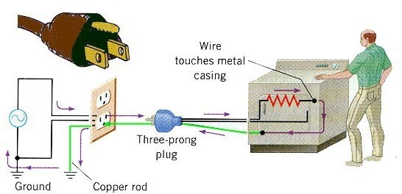
Grounded Appliance

Slide 40
Some questions for the audience
What voltage is generated at power stations?
What is the fuse current rating of company fuse?
What are types of house wiring?
Can you recall any of the ISI house wiring rules?
Give an example for where 3 way switches are used.

Slide 41
THANK YOU

