Slide 1

Principle of Electric Motor and Generator

Slide 2
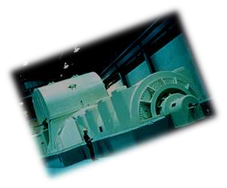
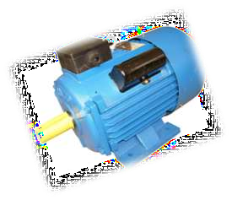
Content :
Electric Generator
Introduction
Principle
Construction
Working
Types of electric Generator
Uses of electric Generator
Electric Motor
Introduction
Principle
Construction
Working
Types of electric motor
Uses of electric motor

Slide 3
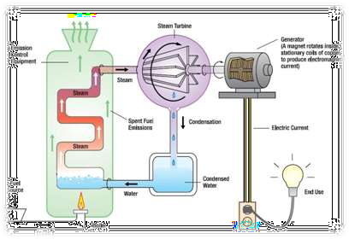
What is Electric Generator ??
The electrical generator was first invented by the Hungarian inventor and engineer Anyos Jedlik sometime between 1827 and 1830. Jedlik invented the generator
An electric generator is a device which converts Mechanical energy to Electrical energy.
Electric generator is also called
Dynamo.

Slide 4
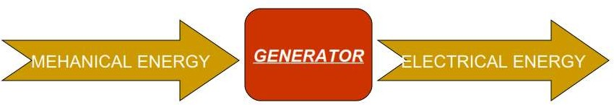
What is Electric Generator ??
An electric generator is a device which converts Mechanical energy to Electrical energy.
•
Electric generator is also called Dynamo.

Slide 5
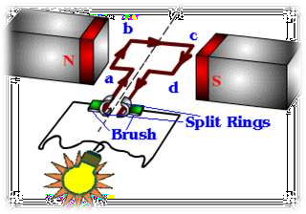
Principle of an electric generator
Generator works on the principle of electromagnetic induction discovered by Michael Faraday in 1831-32..
Faraday’s Law : An Electro Magnetic Field (E.M.F.) is induced in a conductor (i.e. a coil) when the magnetic field around it changes. The magnitude of the E.M.F. is proportional to the rate of change of the field, or rate of cutting flux, while its direction depends on the direction of the rate of change.

Slide 6
Construction of a Generator
Simple loop generator is having a single-turn rectangular copper coil rotating about its own axis in a magnetic field provided by either permanent magnet or electro magnets.
In case of without commutator the two ends of the coil are joined to slip rings which are insulated from each other and from the central shaft.Two collecting brushes ( of carbon or copper) press against the slip rings.Their function is to collect the current induced in the coil. In this case the current waveform we obtain is alternating current. In case of with commutator the slip rings are replaced by split rings.In this case the current is unidirectional

Slide 7
Working of Electrical Generator
Most metals have electrons that can move around freely. These electrons allow electricity to move through the metal, transmitting electrical energy from one place to another. These metals are called electrical conductors. A generator is a device that is used to move electrons through a conductor to give electric power. It does this by using a magnet that forces electrons to move along a wire at a steady rate while putting pressure on them. With the help of a generator, the electrons can transmit electric energy from one point to another. The difference in the number of electrons and the pressure that the generator applies is what creates the different electric currents. The generator spins at a certain number of rotations per minute. The number of electrons that move is measured in amps. The pressure is measured in volts

Slide 8
Types of Electric Generators
Electric generators types depend on the type of generating equipmentemployed, the electrical energy produced is either direct current (DC) or alternating current (AC).
AC generators are classified as single-phase or polyphase. A single-phase generator is usually limited to 25 kW or less and generates AC power at a specific utilization voltage. Polyphase generators produce two or more alternating voltages (usually two, three, or six phases)
DC generators are classified as either shunt, series, or compound- wound. Most DC are the compound-wound type. Shunt generators are usually used as battery chargers and as exciters for AC generators. Series generators are sometimes used for street lights. The emf induced in a DC generator coil is alternating. Rectification is needed to direct the flow of current in one direction. The generator rotating commutator provides the rectifying action.

Slide 9

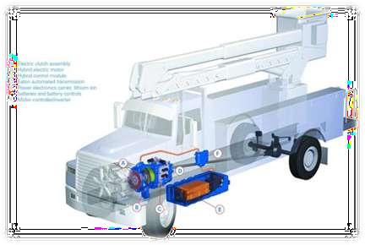
Uses of Electrical Generator
Hybrid electric vehicle (HEV) drive systems, automotive starter generators,aircraft auxiliary power generation, wind generators, high speed gas turbine generators
An a.c. generator, or 'alternator', is used to produce
a.c. voltages for transmission via the grid system or, locally, as portable generators.

Slide 10
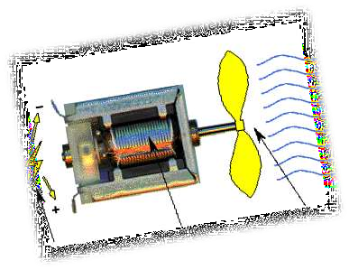
What is an Electric Motor ??
The first electric motor was invented by William Sturgeon in 1832. and successful one was done in 1873
A machine that converts electricity into mechanical energy or motion.
An electric motor is a type of prime mover for a mechanical system.

Slide 11
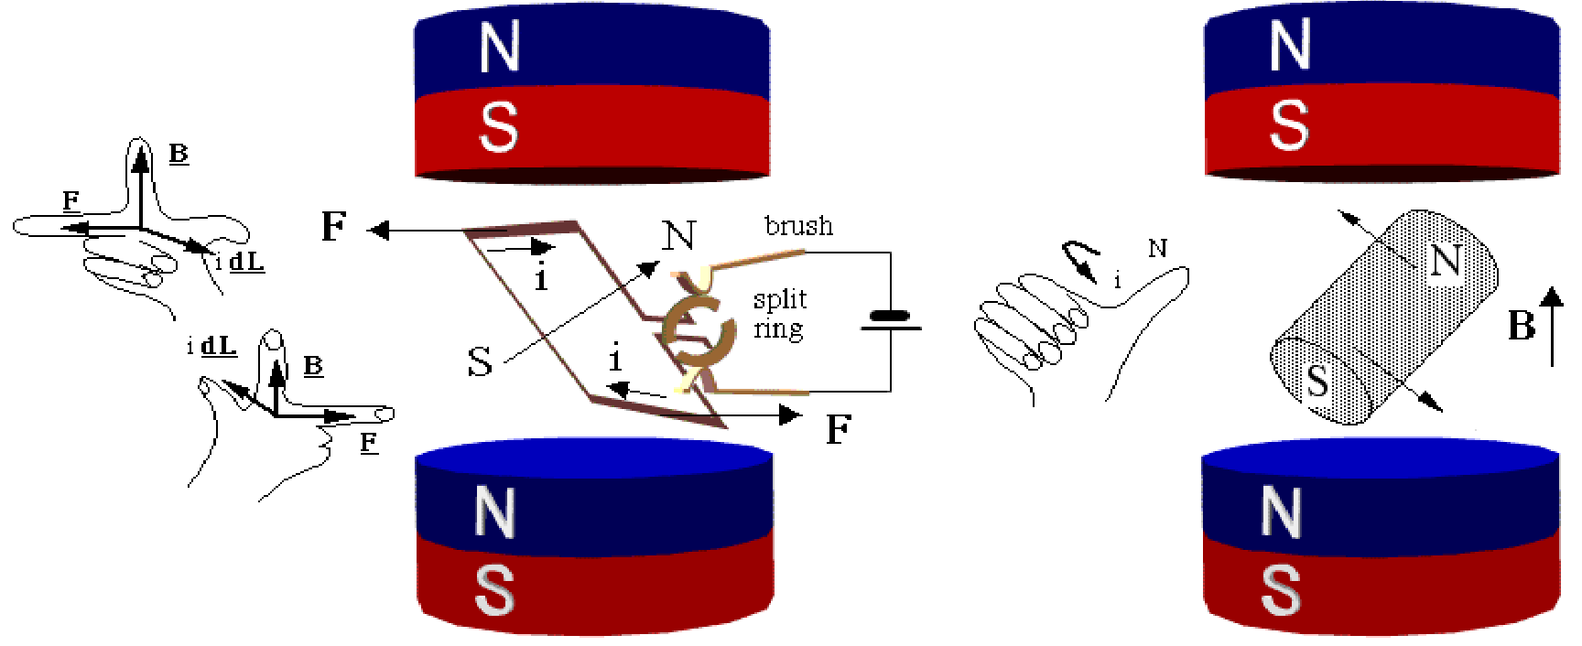
Principle of an Electric Motor
Electric motor works on the principle that a current carrying conductor placed in a magnetic field experiences a force.

Slide 12
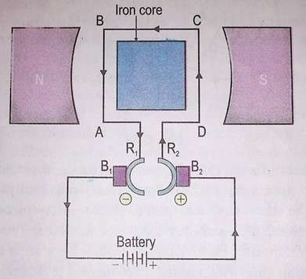
Construction of an Electric Motor
Armature coil : A large number of turns of insulated copper wire wound on iron core in rectangular shape forms an armature coil ABCD .
Strong magnet : The armature coil is placed in between two pole pieces (N and S) of a strong magnet. This provides a strong magnetic field.
Split ring commutator : It consist of two halves (R1 and R2) of a metallic ring. The ends of the armature coil are connected to direction of current in the armature coil.
Brushes : Two carbon brushes B1 and B2 are used to press the commutator.
Battery : The battery supplies the current to the armature coil.

Slide 13
Working of the electric motor:
When current is passed through the coil ABCD, arms AB and CD experience force. According to fleming’s left hand rule the force experienced by arm AB is in the downward direction and arm CD in the upward direction. Both these forces are equal and opposite. This force rotates the coil in clockwise direction until the coil is vertical. At this position, the contact between commutator and brushes break. So the supply to the coil is cut off. Thus no force acts on the coil. But the coil does not stop due to inertia. It goes on rotating until the commutator again comes in contact with the brushes B1 and B2. Again the current starts passing through coil and the arm AB rotates through 900, 1800, 2700 and 360 degrees. Now the force acting on arm AB is downward and CD is upward. Again this force moves the coil in clockwise direction.
Thus, the coil rotates with the help of electrical energy. The coil of DC
motor continues to rotate in the same direction.

Slide 14
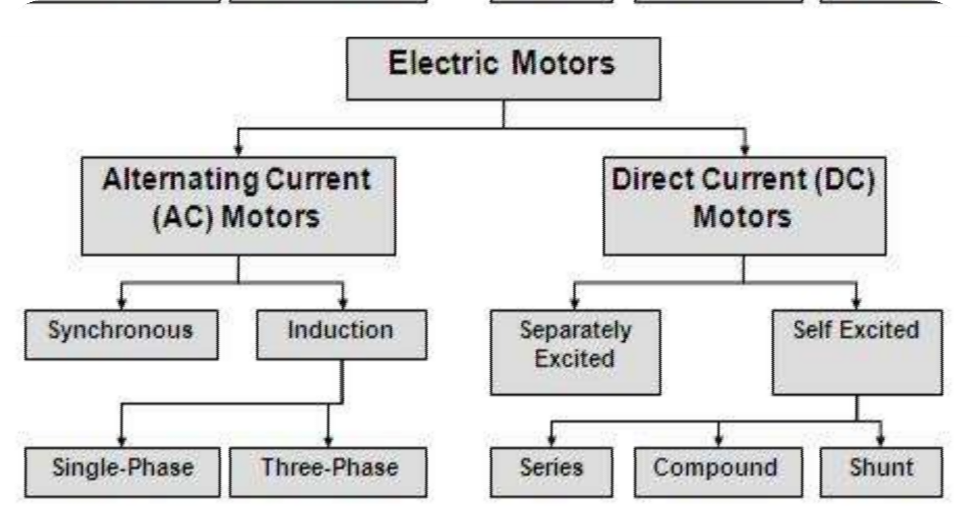

Types of Electric Motor

Slide 15

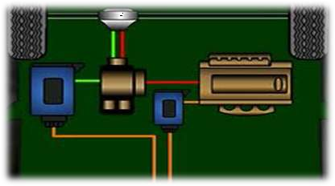
Uses of Electric Motor
Motors have a wide variety of uses and are found in cars, clocks,
drills, fans, fridges, hair dryers, toothbrushes, vacuum cleaners,
water pumps (for fish tanks, central heating, fire fighting) washing machines, hard disk drives, DVD players, electric vehicles
and industrial equipment including extruders,
fork-lift trucks, lathes, mills, hoists, robots and winches.

