Slide 1





Electric Fan
CONSUMER ELECTRONICS

Slide 2
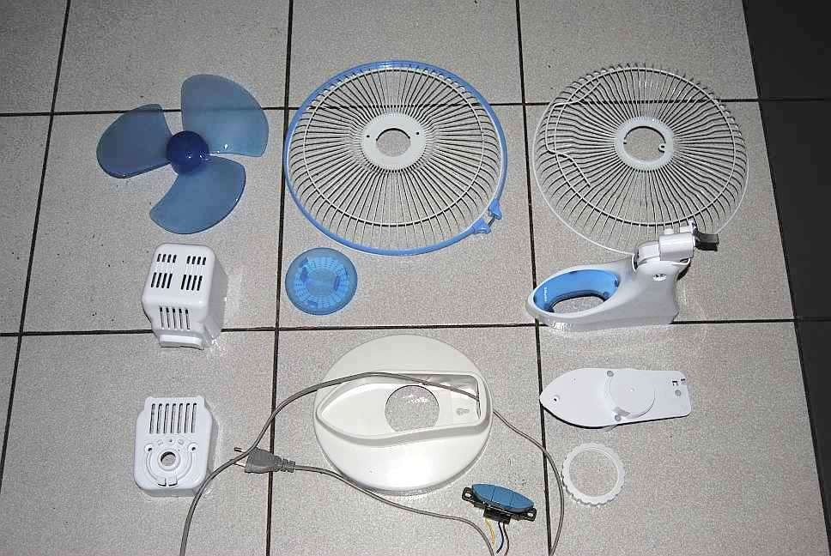

External Parts

Slide 3
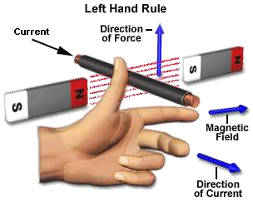
Fleming’s Left Hand Rule
Current
Force
Magnetic Field
Current

Slide 4
Objectives
The students can identify the internal parts of an electric fan.
The students can able to perform troubleshooting in the electric fan in setting the rotor’s speed.

Slide 5
What is Electric fan?
It is a type of electronic appliances that is run by an electronic motor.

Slide 6
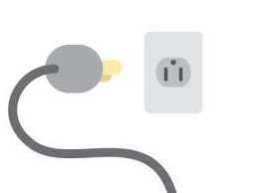
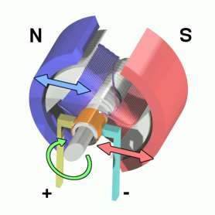
Purpose Of The Electric
Fan
To convert electrical energy to mechanical energy.
Electrical
Energy
Mechanical Energy

Slide 7
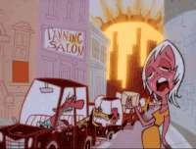
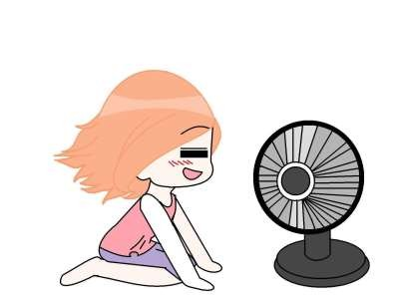
To make consumers feel comfortable during hot seasons or summer days.

Slide 8
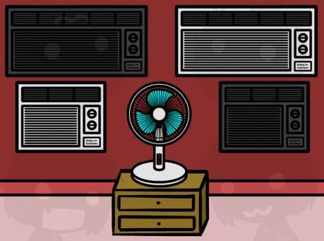
Internal Parts Of The Electric Fan

Slide 9
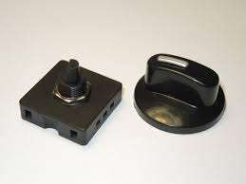
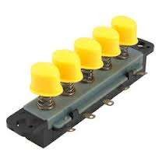
Selector Switch
It is a part of electric fan that can intensify the produce air for the consumers.
Rotary Switch
Push Button Switch

Slide 10
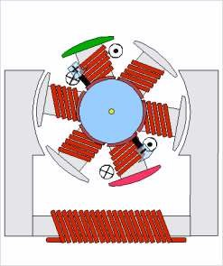
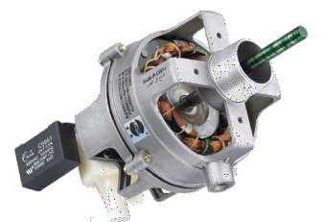
Electric Motor
It is the main part of the electric fan that produces mechanical energy to make the propeller rotate.

Slide 11
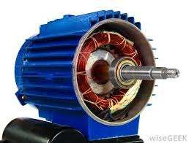
Rotor
It is the movable part of the electrical motor that rotates

Slide 12
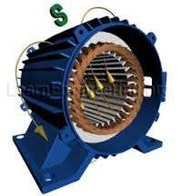
Stator
It is a non movable part of the electric motor that provides electro magnetic energy to the rotor.

Slide 13
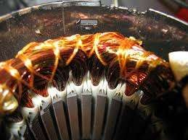
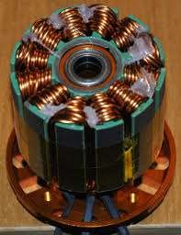
Copper Winding
Copper Winding in
It is a set of copper wire that
Stator
supplies electricity in the stator and rotor.
Copper Winding in Rotor

Slide 14
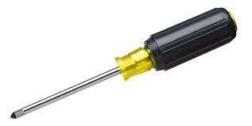
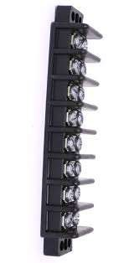
Setting the speed of the electric fan requires:
Electric Motor
Selector Switch
Handtools
Terminal Block

Slide 15
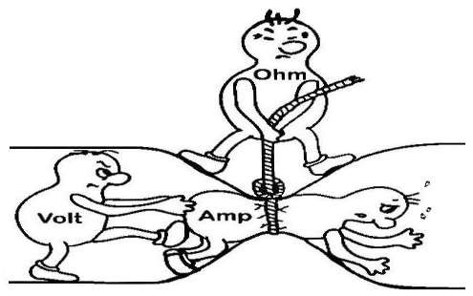
Current and Resistance
The Higher Resistance means a Low Current which will result slow rotation of the propeller.

Slide 16
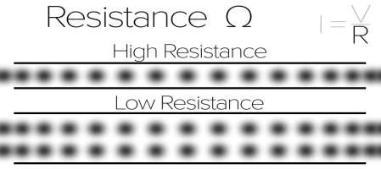
The Lower Resistance means a Higher Current which will result in fast rotation of the propeller.

Slide 17
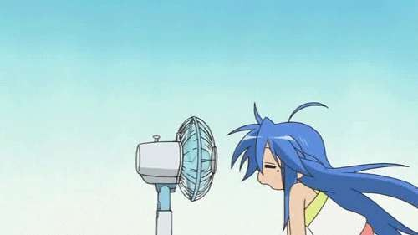
Fan Speed Control

Slide 18
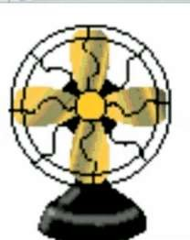
Since that the no.1 in the selector switch has a slow rotation of rotor it means that the resistance needed is high.

Slide 19
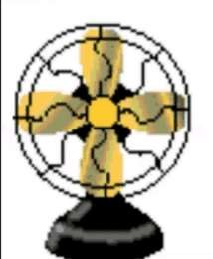

No.2 in the selector switch will have a moderate resistance and the no.3 has a lowest resistance

Slide 20
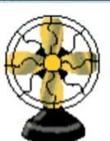

0
1
2
3

Slide 21
0
3
2
1

Slide 22
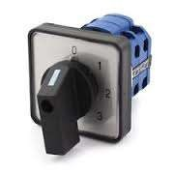
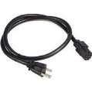
Terminal Block
Example resistance
300
Selector Switch
Motor
3
ohms 320
2
1
Common
ohms 330
ohms
Common
Line
Cord

Slide 23
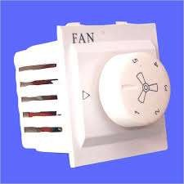
Fan Regulator

Slide 24

◻ Fan Regulators have an important place in the electrical switch boards.
◻ Fan Regulators are very similar to light dimmers . Their function is regulate/control the speed of the fan and provide a convenient environment environment for the residents.
◻ The traditional regulators which are bulky use a resistance having taps and connected in series with the fan.when we move the knob different amount of resistance gets inserted in the circuit

Slide 25
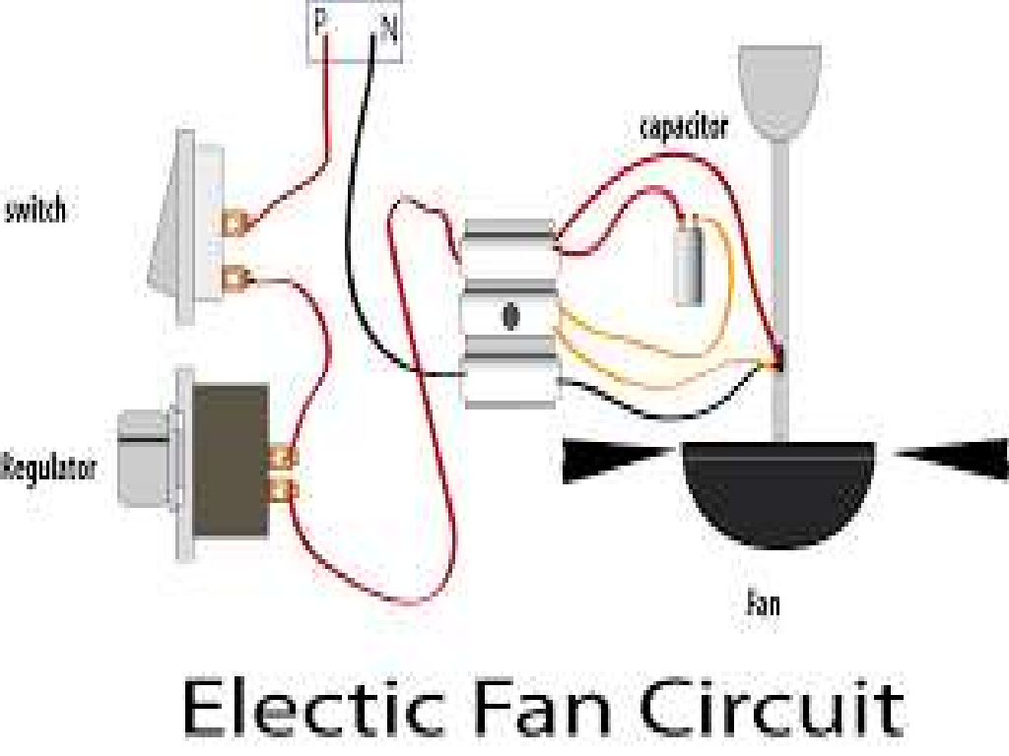

Slide 26
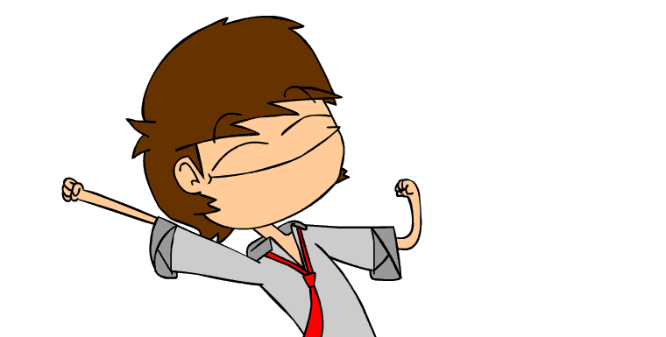
Let’s Have a Quiz

Slide 27
Identification

Slide 28
1)
It is a movable part of the motor which rotates.

Slide 29
2)
It is a non movable part of the electric motor that provides electro magnetic energy to the rotor.

Slide 30
3)
It is a part of electric fan that can intensify the produce air for the consumers.

Slide 31
Picture Identification

Slide 32
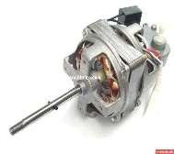
4)

Slide 33
5)

Slide 34
Identification

Slide 35
1) Rotor
It is a movable part of the motor which rotates.

Slide 36
2) Stator
It is a non movable part of the electric motor that provides electro magnetic energy to the rotor.

Slide 37
3) Selector Switch
It is a part of electric fan that can intensify the produce air for the consumers.

Slide 38
Picture Identification

Slide 39
4) Electric Motor

Slide 40
5) Copper Winding

Slide 41
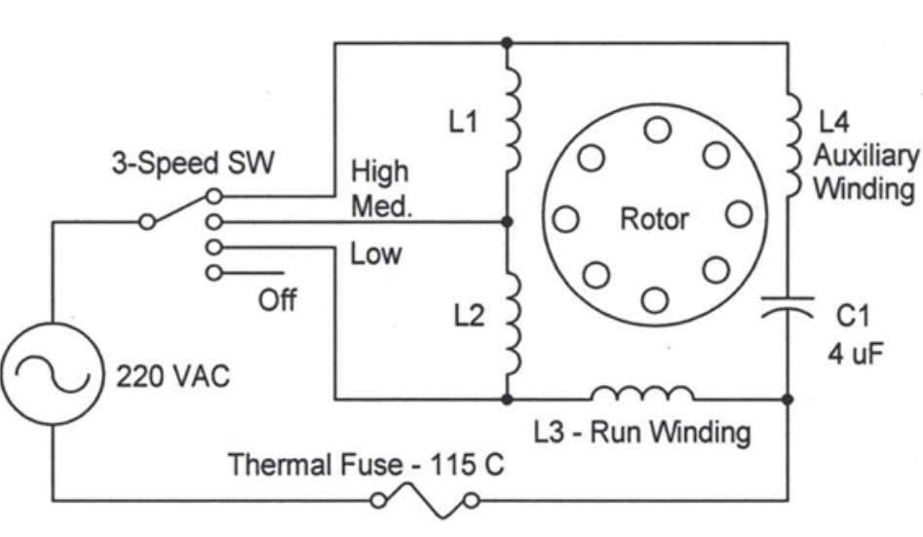
Schematic Diagram of an Electric Fan

Slide 42
Assignment
Research about the different models or types of electric fan and it’s uses.
Write your assignments in your notebook.

Slide 43
Good Bye Class

